Slide 1





BRINGING FUSION POWER TO THE UNITED STATES
June 2025

Slide 2

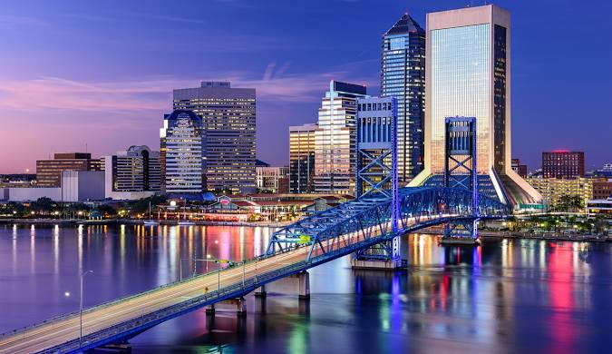






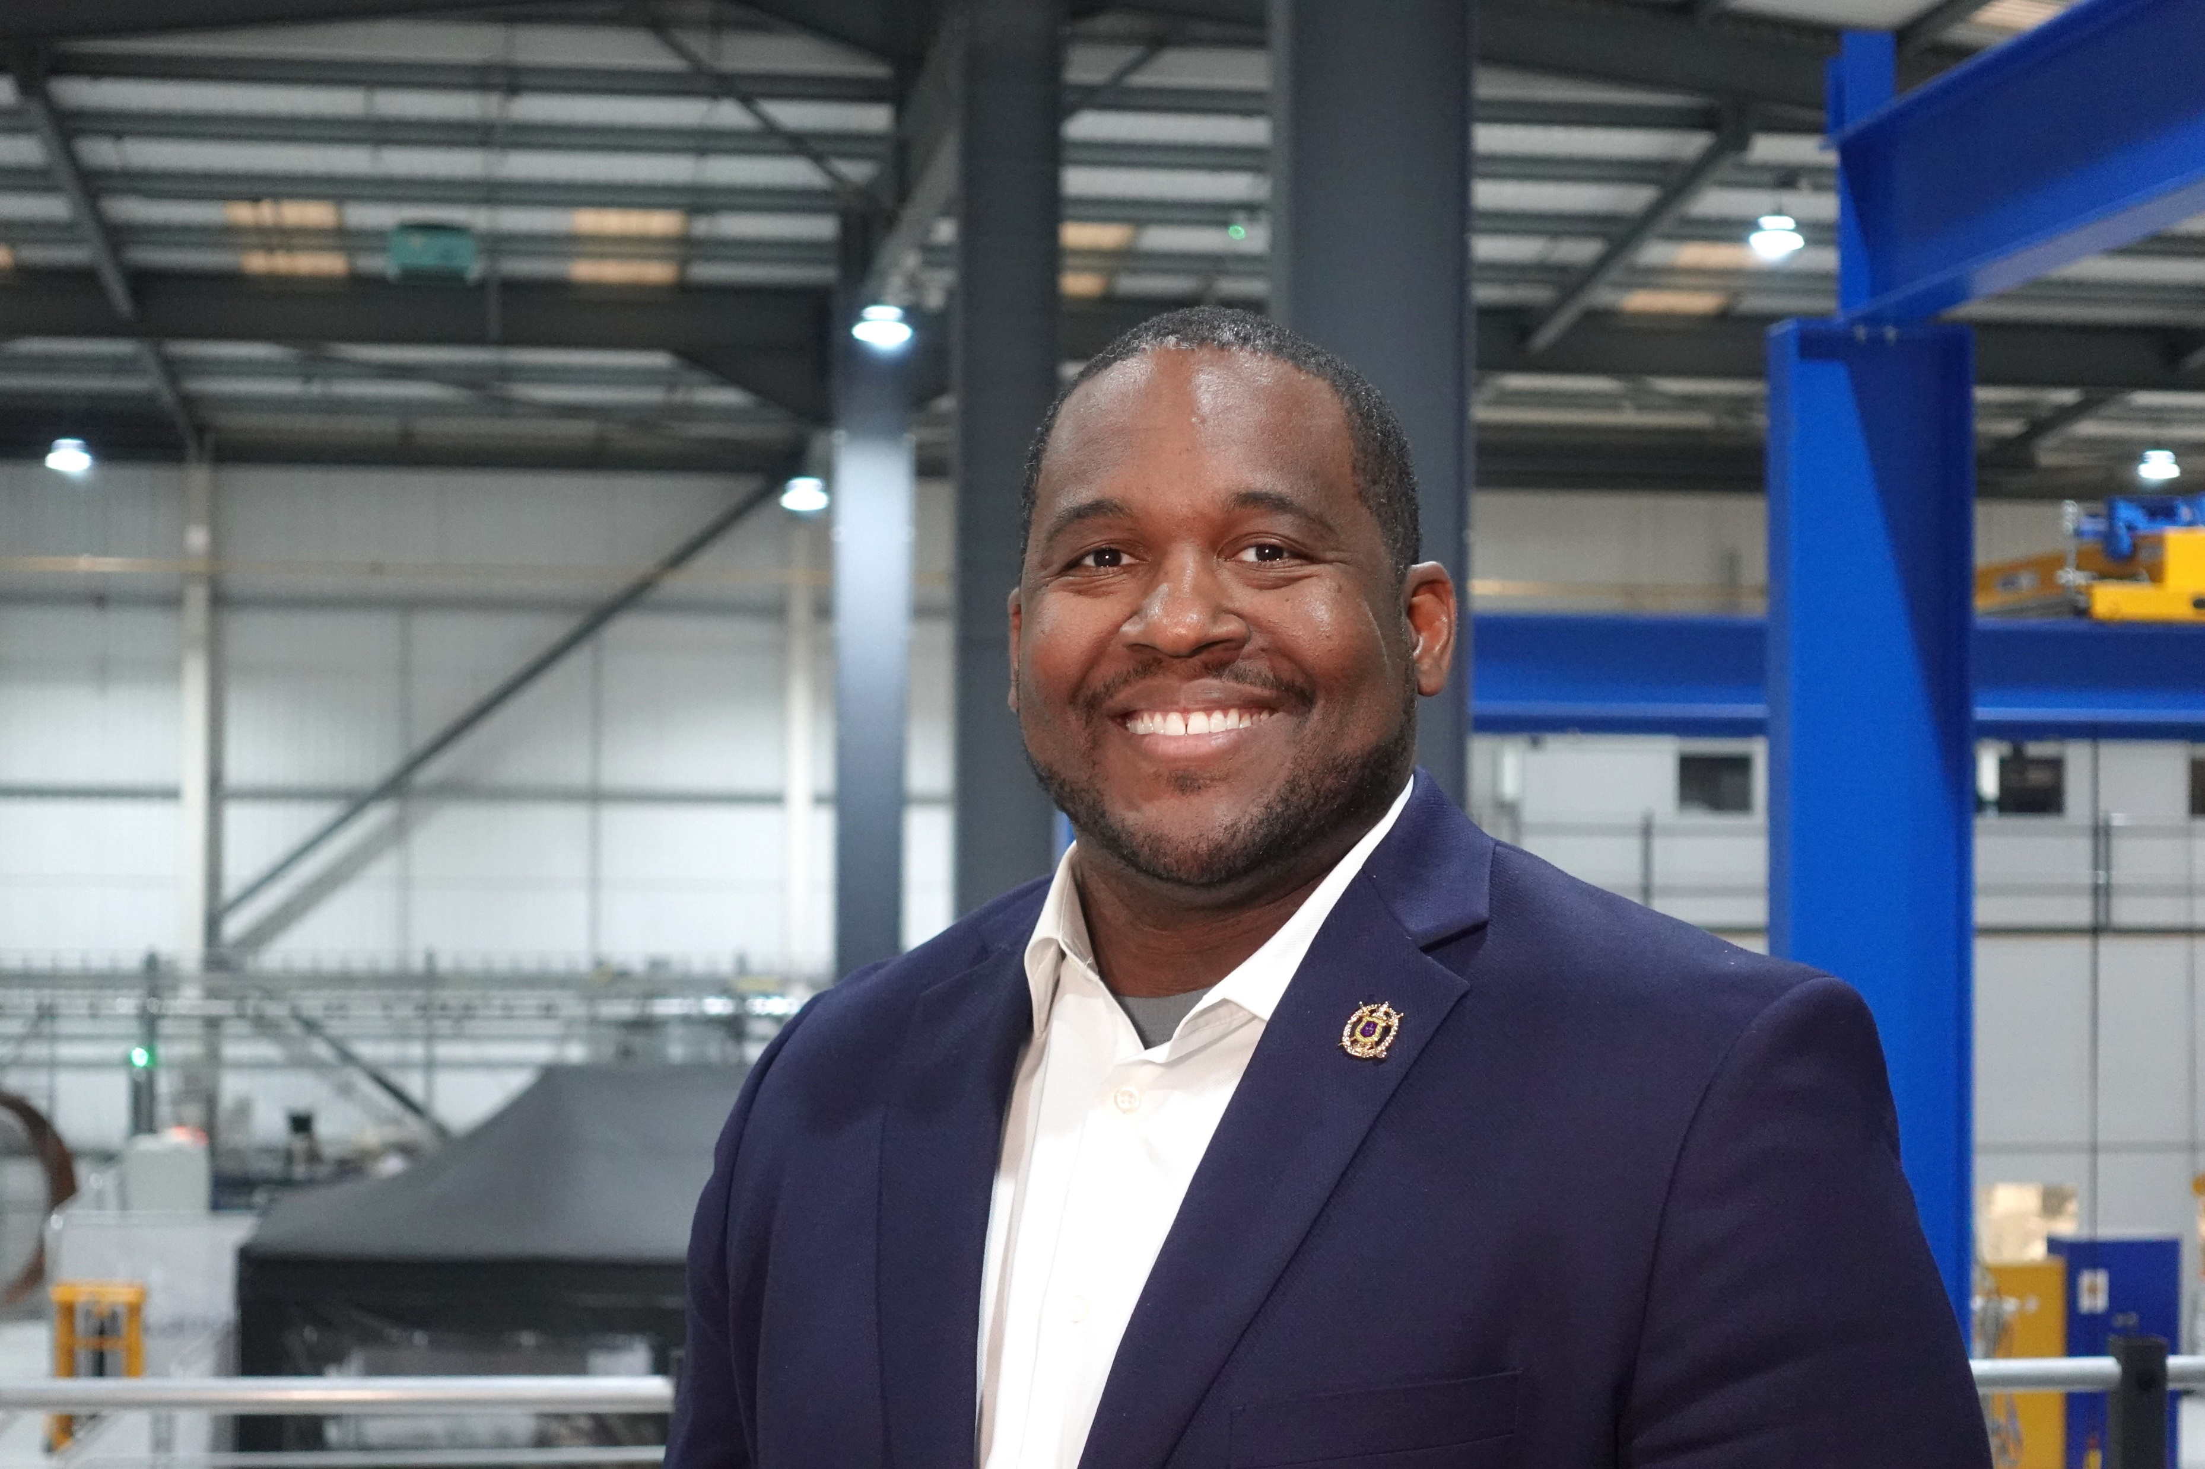


About me
Bachelors in Chemistry from University of Florida
PhD in Chemistry from Florida State University
Masters in STEM Leadership from Brown University
Former Adjunct Professor at University of South Carolina
Principal Scientist at DOE Lab (SRNL)
Business Owner for Tutor Doctor of Evans
Technical Project Manager at Tokamak Energy
Married (Just celebrated 4.5 years)
5 kids (16-3)

Slide 3
Introduce Tokamak Energy.
What is fusion and why we need it.
Our fusion technology & facilities.
Pathways to fusion in UK, USA and KSA.
agenda

Slide 4
Introduce Tokamak Energy.
1

Slide 5














WE ARE TOKAMAK ENERGY.
THE LEADING GLOBAL FUSION COMPANY.
OXFORD, UK
GLOBAL HEADQUARTERS
PRINCETON, NJ
U.S. SUBSIDIARY
TOKYO, JP
JAPANESE SUBSIDIARY
Partnering with:
Partnering with:
Partnering with:
260 people worldwide
$335 million raised

Slide 6
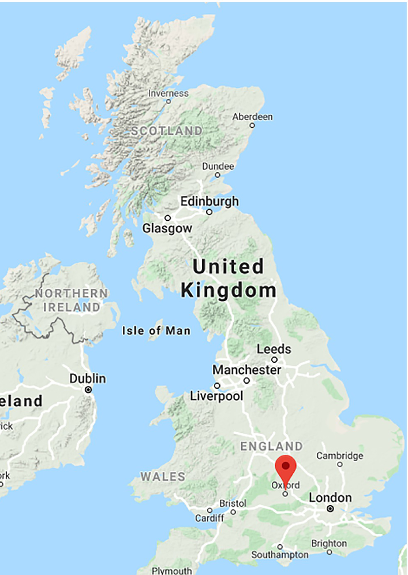
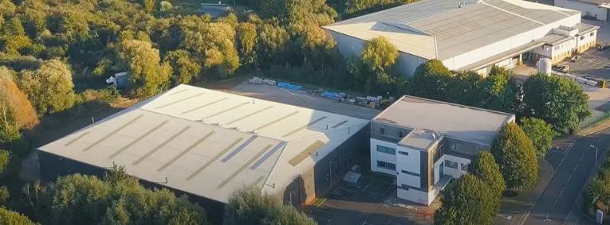
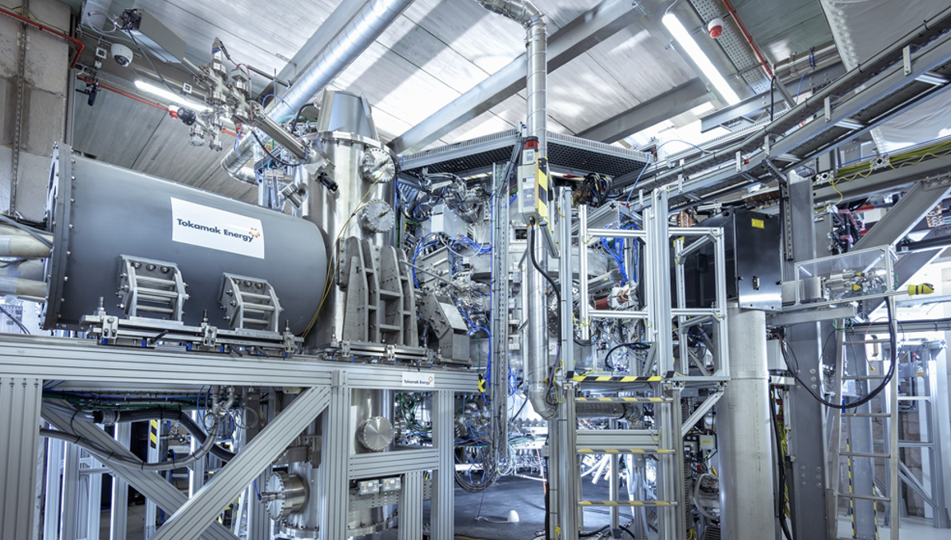
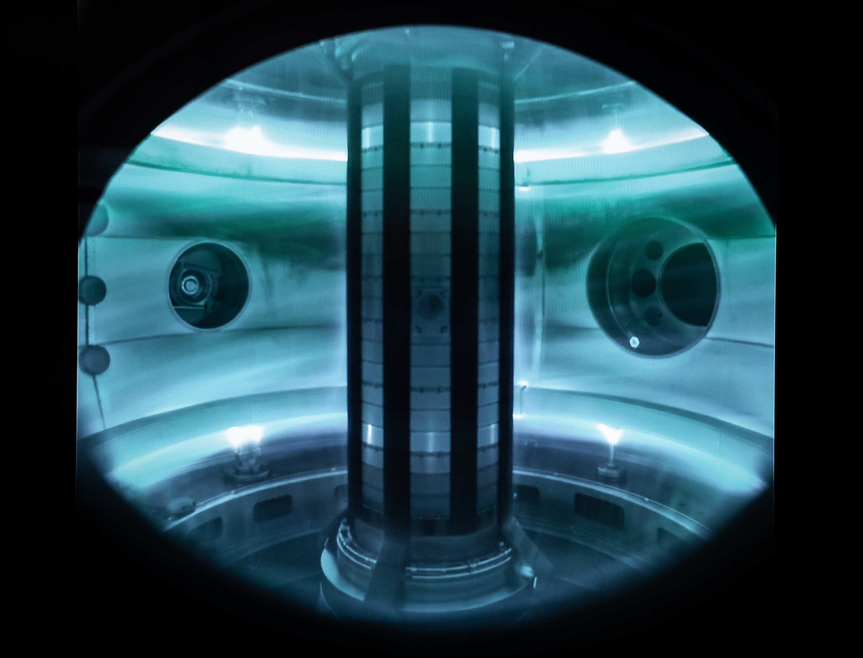

Our HQ near oxford is home to world-leading our fusion R&D facilities
ST40

Slide 7
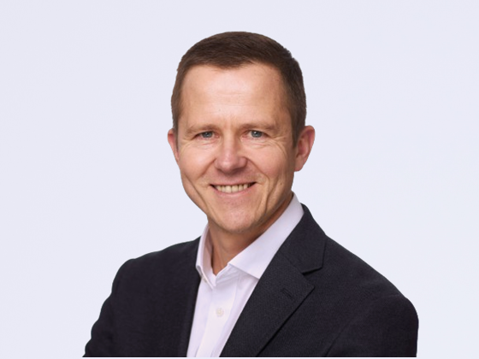
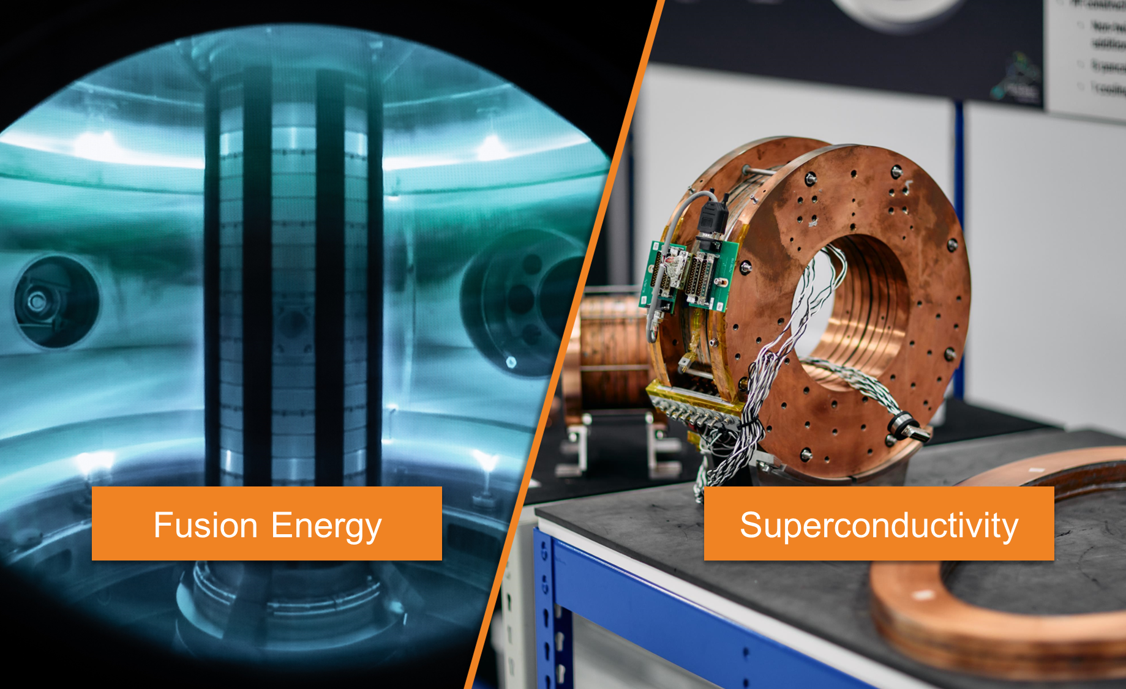

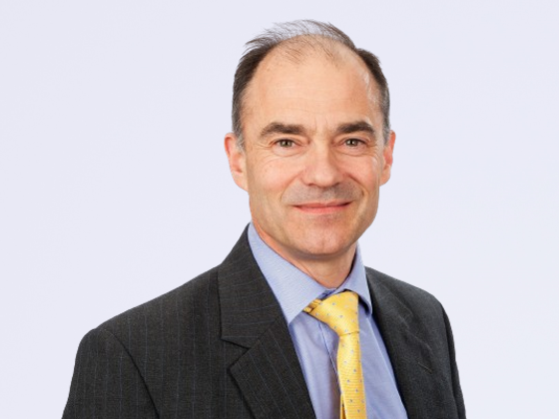



With strong commercial leadership, we are pioneering two breakthrough technologies
Warrick Matthews
Chief Executive
Previously
Chief Procurement Officer
Sir Warren East
Board Director
Previously
Chief Executive Officer
Erik Bonino
Board Director
Previously
UK Chairman

Slide 8
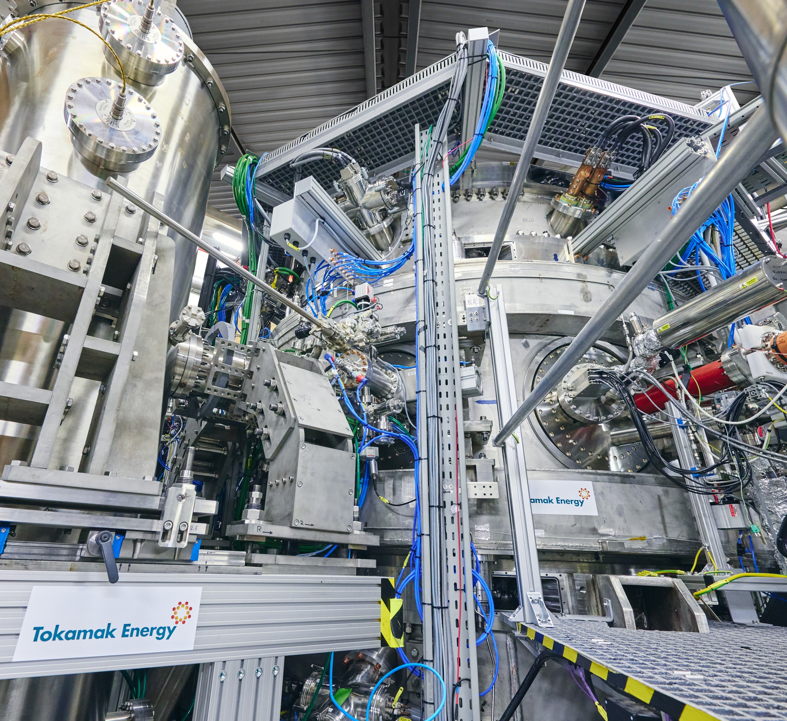
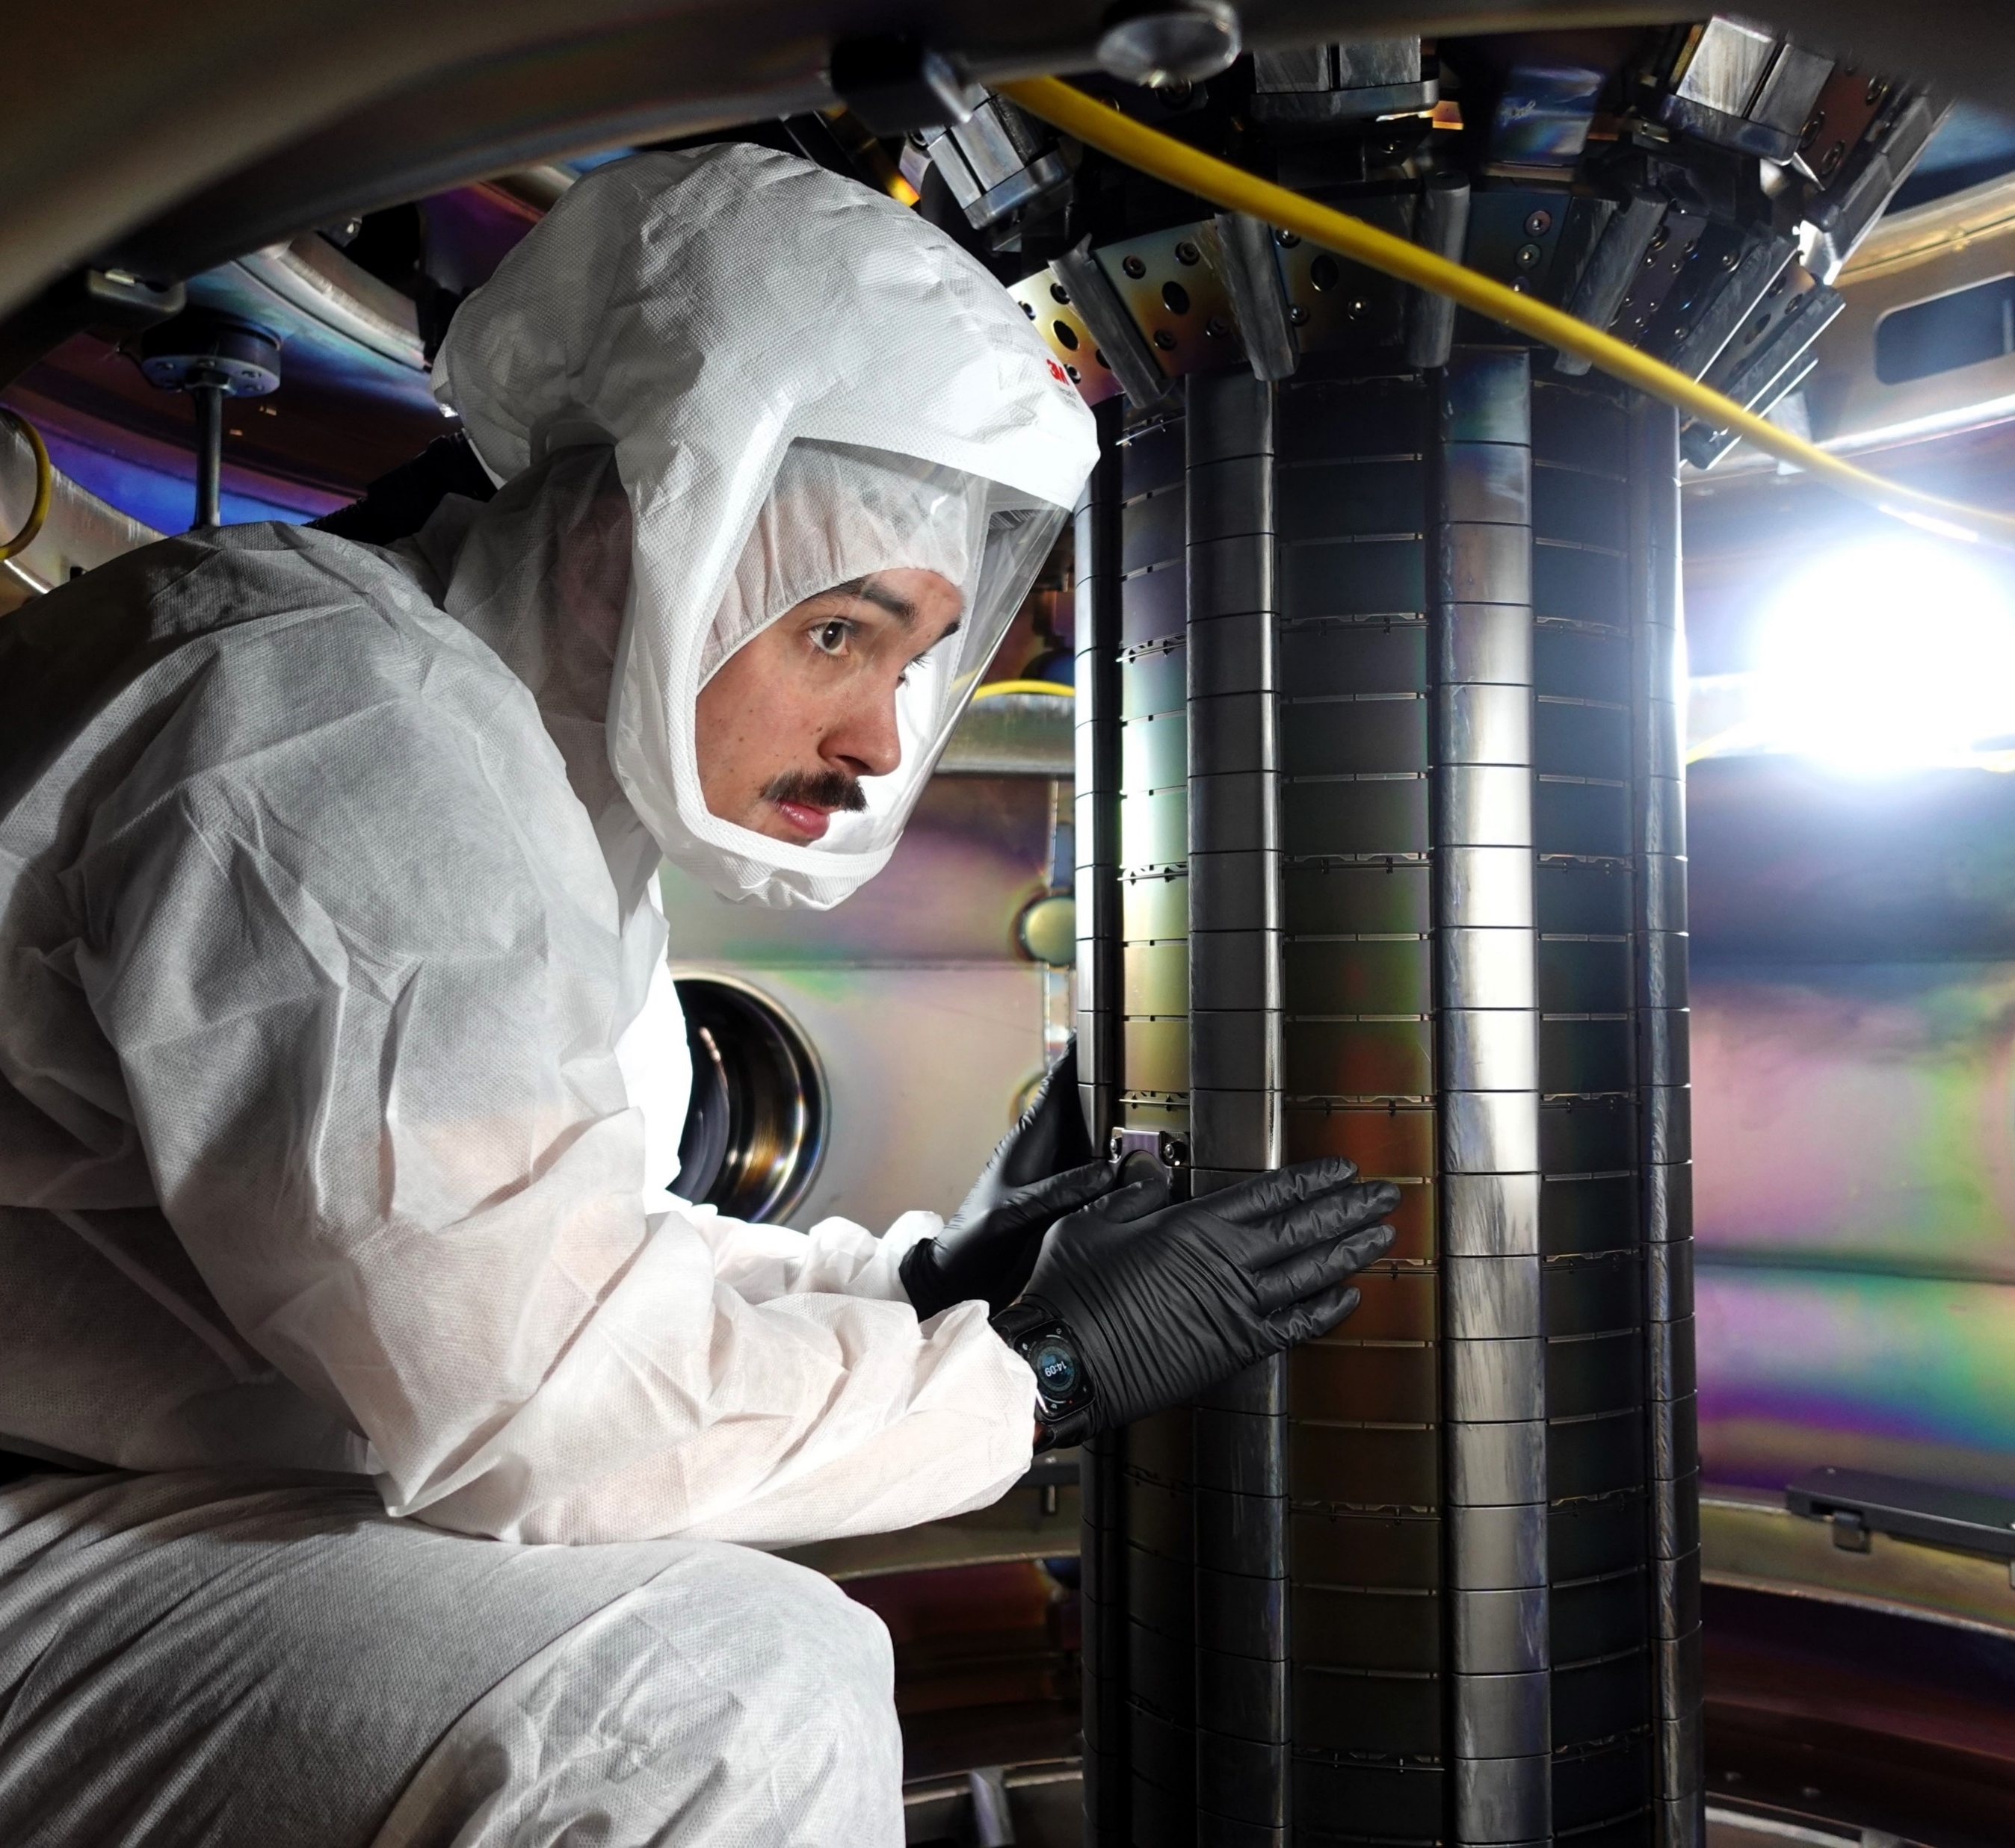
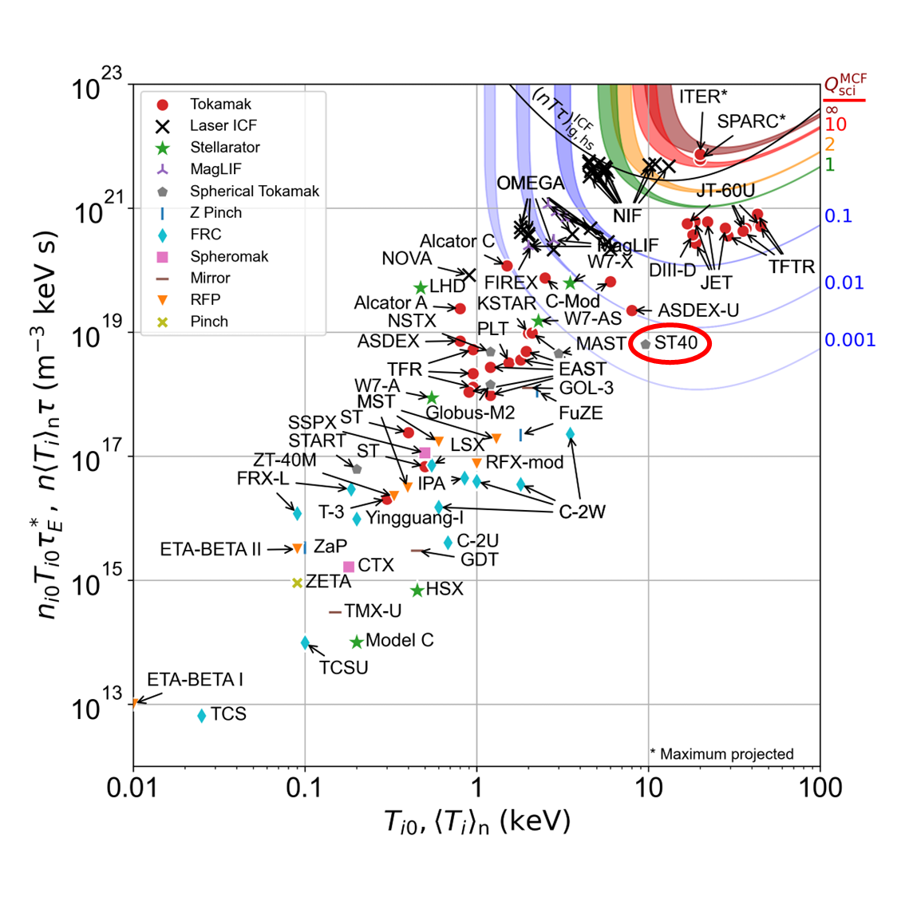
Our unrivalled pedigree in fusion energy
Only company with 10+ years’ experience designing and building tokamaks
Unrivalled experience commissioning, operating and upgrading tokamaks
Peer reviewed highest ‘triple product’ in a privately funded tokamak
6 x 10^18 keV.s/m³

Slide 9
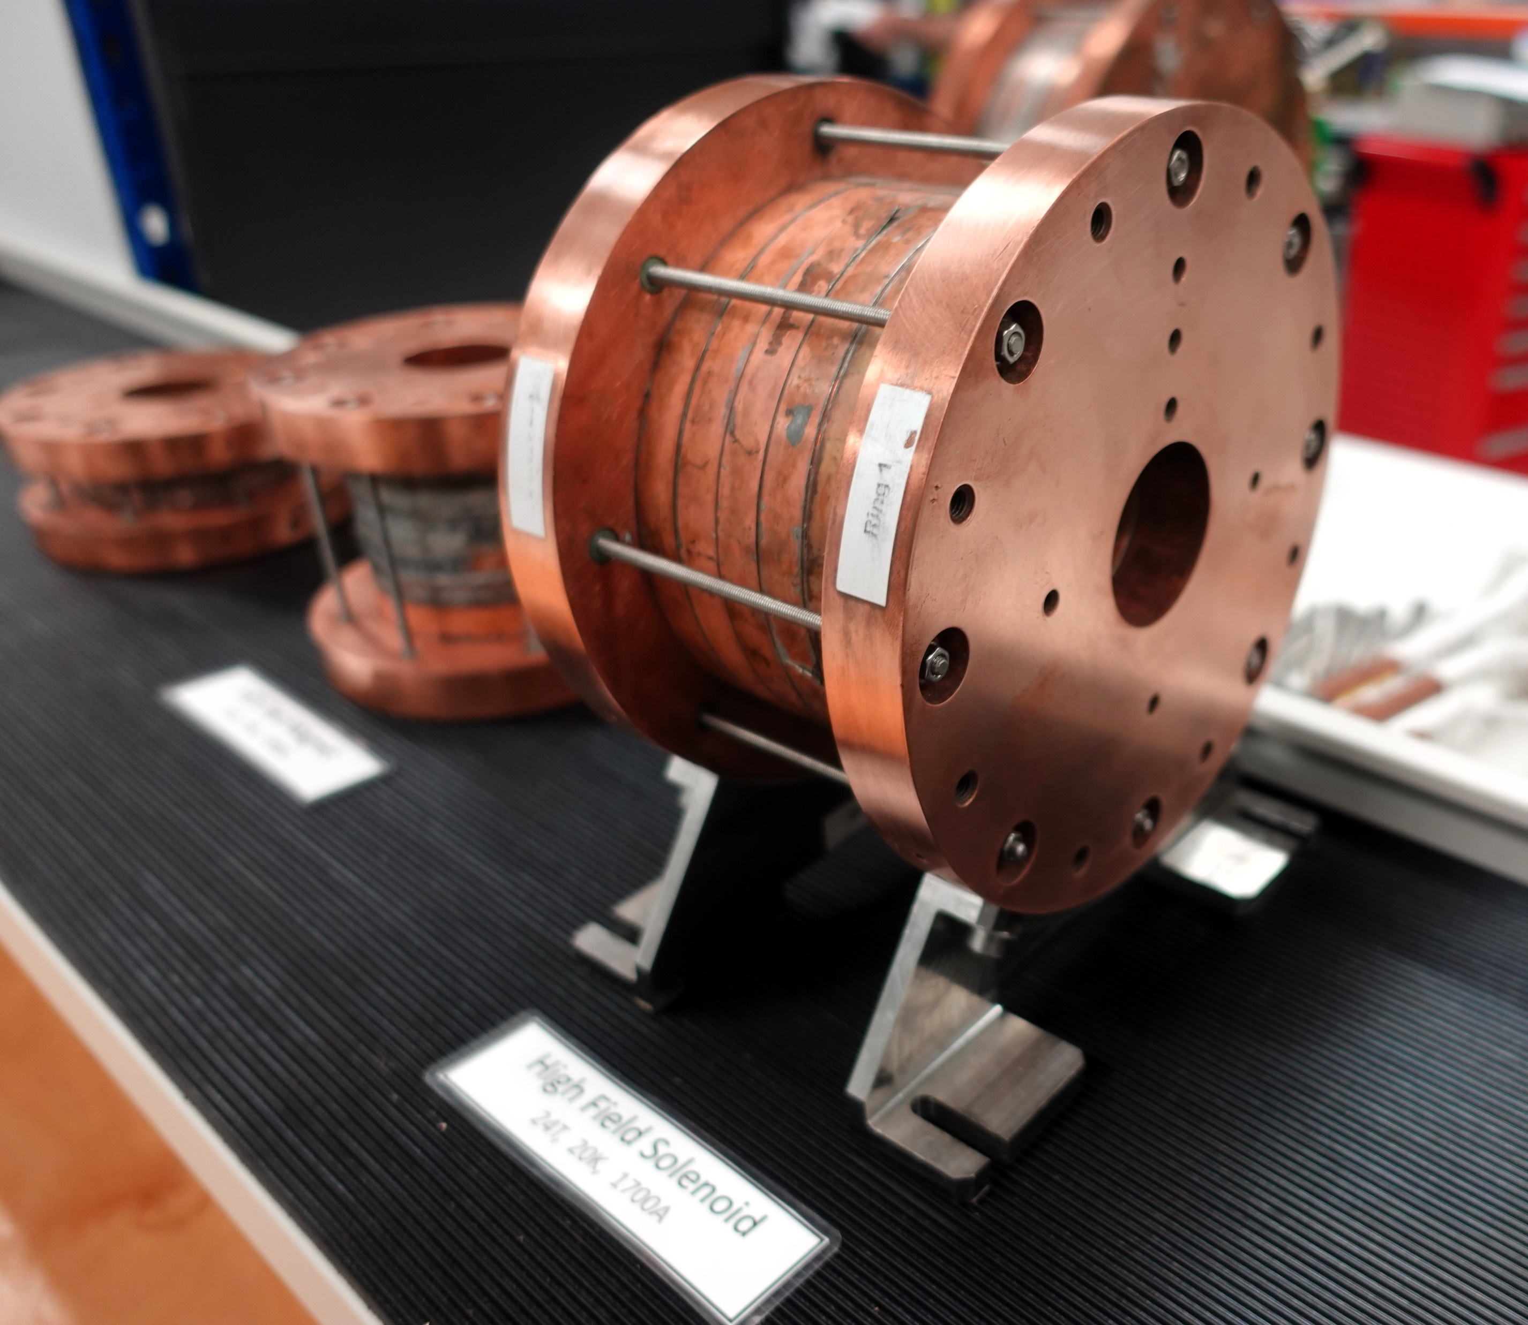
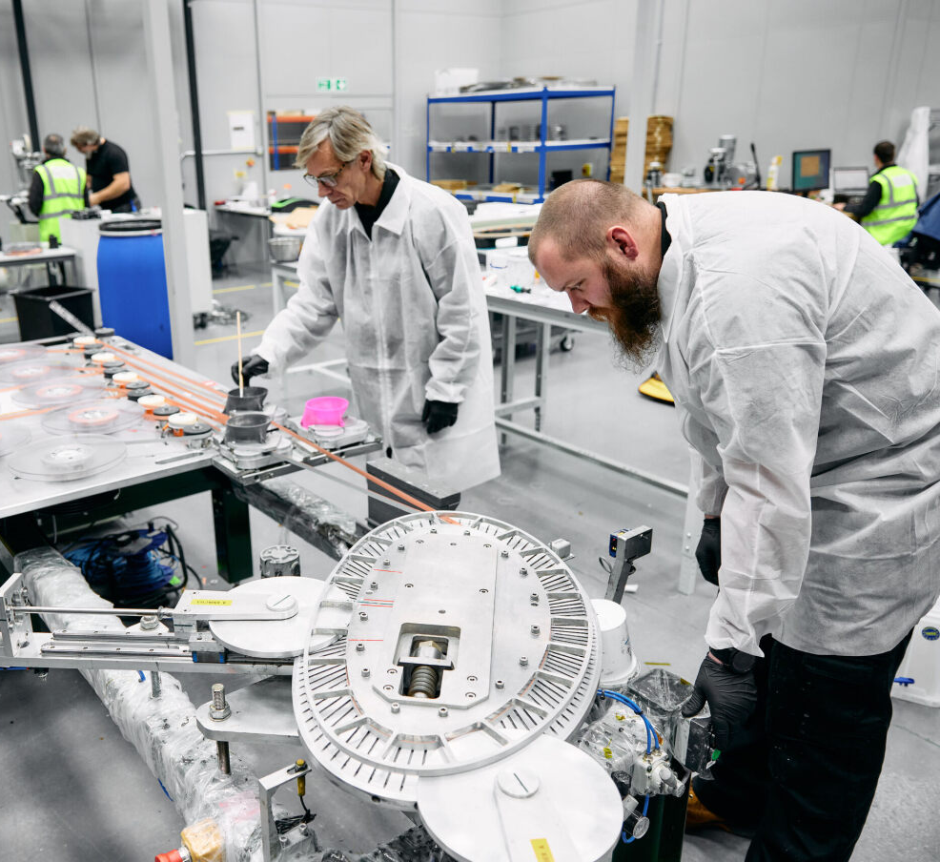
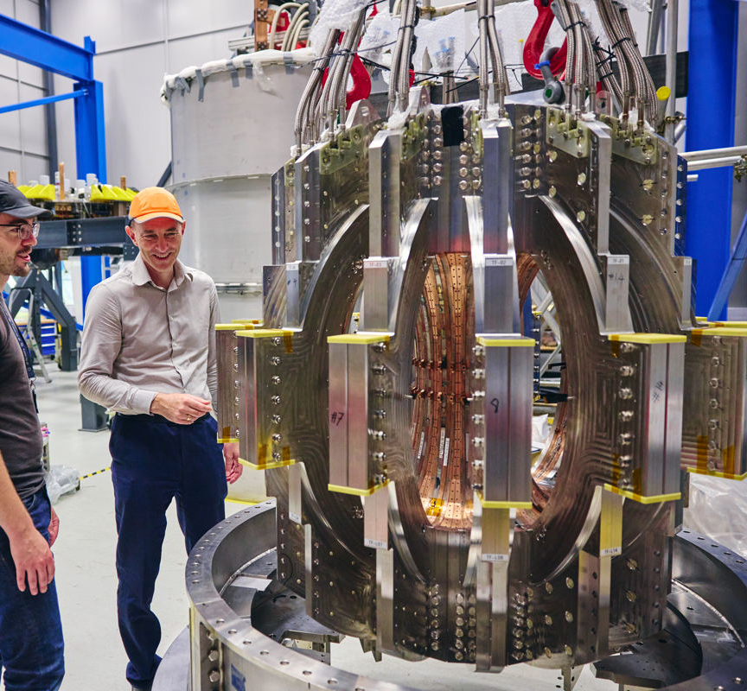
Our unrivalled pedigree in superconductivity
World-record ultra-high field magnet with patented HTS technology
24 Tesla field at 20 K
10+ years expertise in design, modelling & manufacture of robust, quench-safe HTS magnets
Built world first high-field HTS fusion magnet system in tokamak configuration – ‘Demo4’

Slide 10



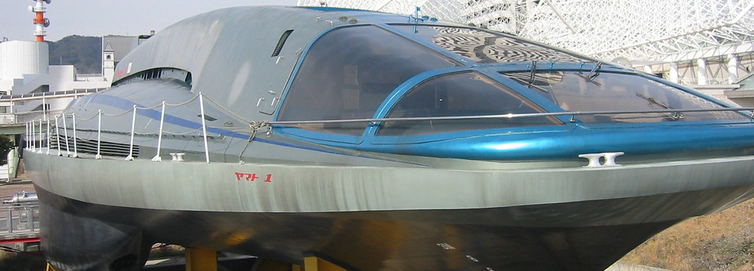
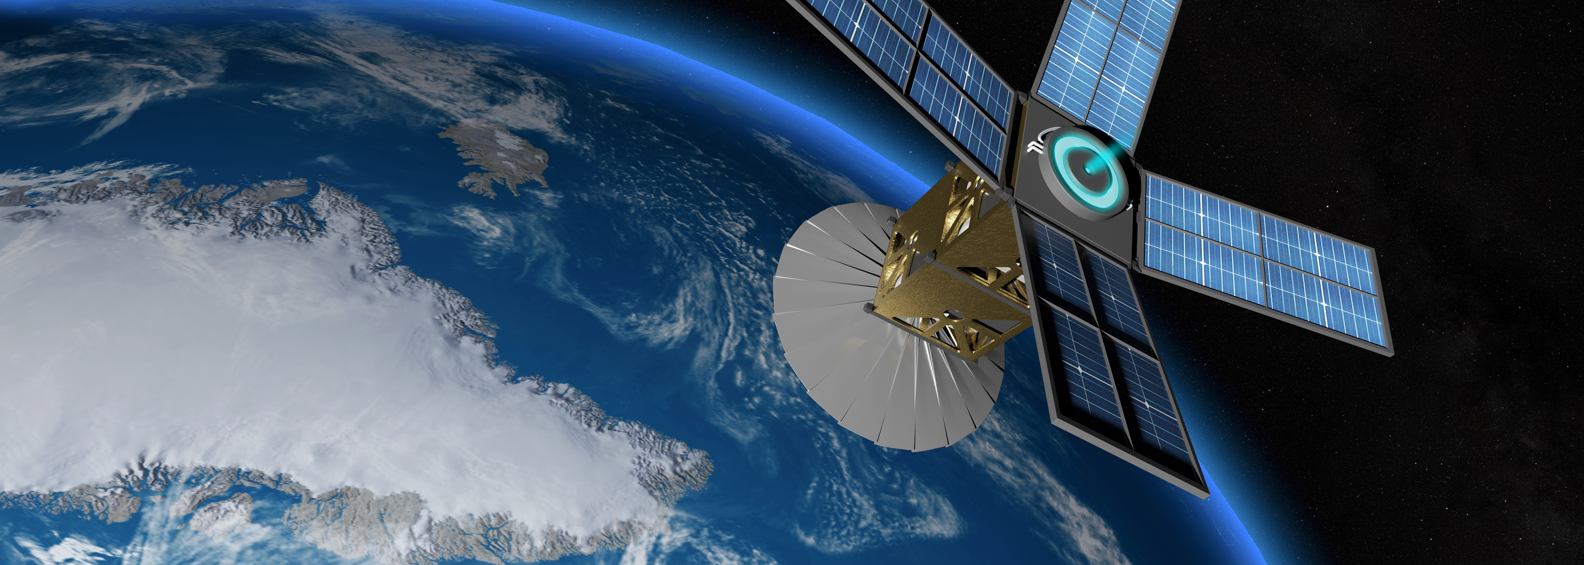
Our HTS technology is being commercialised today through our business unit
Fusion and renewable energy
Science and healthcare
Mobility
Security
  Next-generation magnetically confined fusion energy devices
  Enhanced efficiency and power density of renewable energy devices e.g. wind turbines
  Grid stabilisation and load levelling through energy storage
  High performance, reliable and cost-effective ultra-high field (UHF) devices
  Advanced medical analysis, diagnostic and treatment technologies e.g. compact magnetic resonance, particle therapy
  Materials analysis and characterisation
  High performance, high efficiency, light weight and low emissions mobility on land, in water, air and space
  Lightweight, powerful electric motors
  High speed magnetic levitation transport
  High performance magneto hydrodynamic drive (MHD) propulsion
  Enhanced performance of existing technologies & entirely new applications
  High-performance, efficient and low-noise MHD propulsion
  Energy storage
  Electro-magnetic (EM) pulse and shielding technologies

Slide 11
What is fusion and why we need it.
2

Slide 12
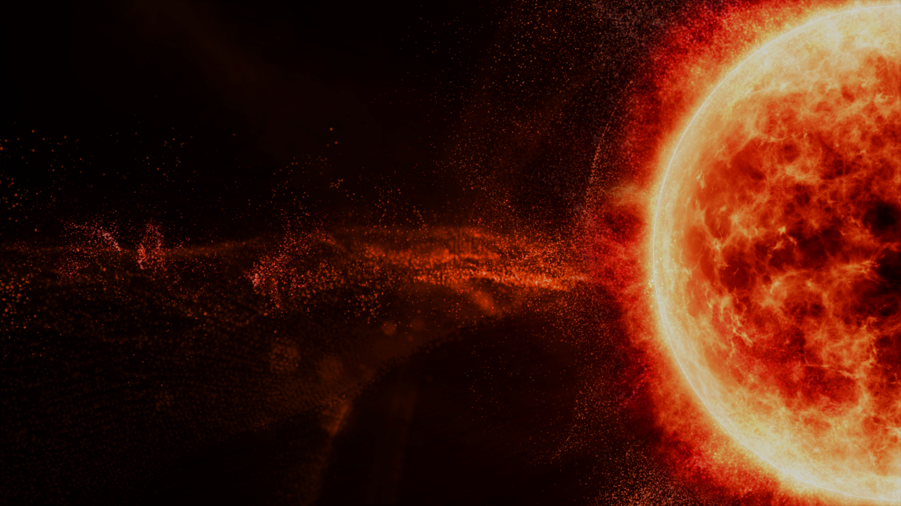




Fusion is the reaction that powers the
sun and all stars.
It offers the potential for clean, safe and abundant baseload energy here on Earth.
Zero CO₂
Firm Power
Limitless Fuel

Slide 13
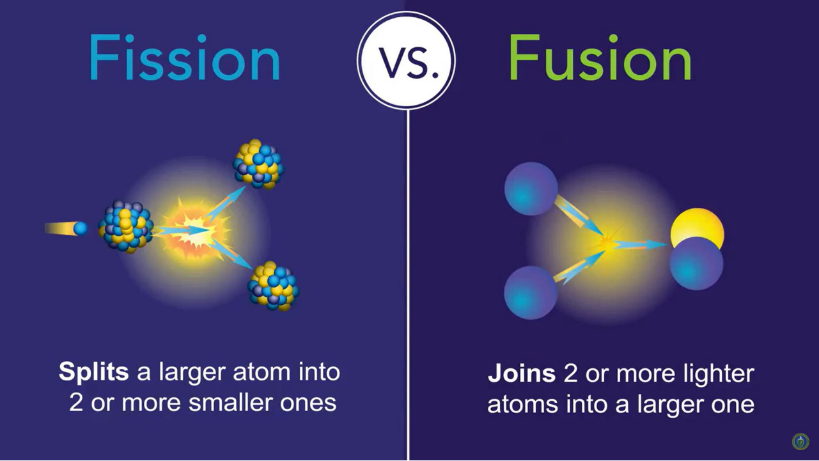
H
H
A high energy nuclear reaction, 4-times more energetic than fission
2
3
1
1
Deuterium
Tritium
+
+
+
+
+
+
17.6MeV
Energy
He
4
2
Neutron
SOURCE: US Department of Energy
Carries 20% of the energy produced
Carries 80% of the energy produced

Slide 14
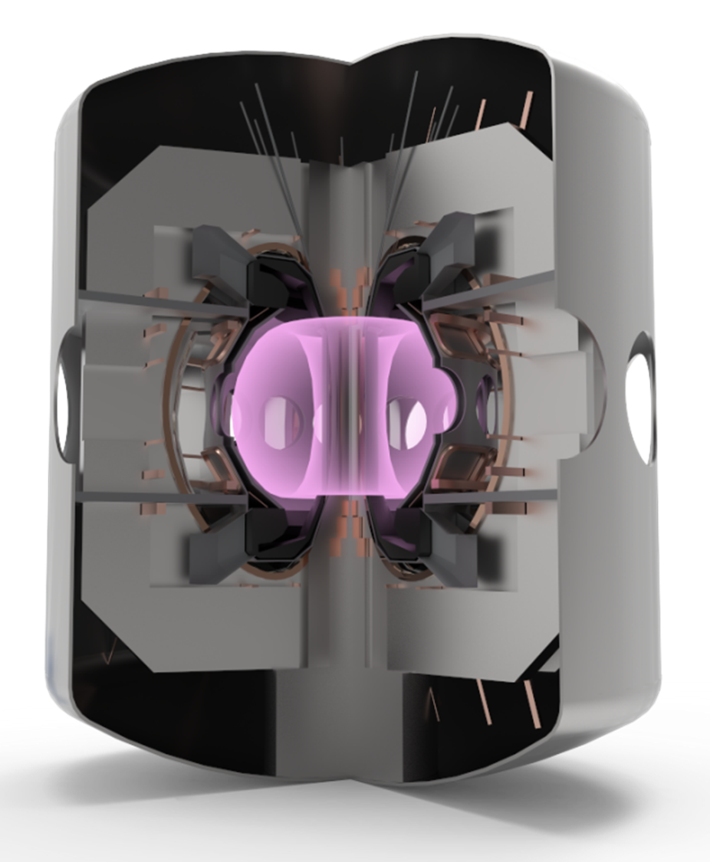
H
H
2
3
To recreate the power of stars on earth, we need…
1
1
Deuterium
Tritium
+
+
+
+
+
+
Density (n)
Heat (T) [>100 million ºC]
Confinement (τ) [magnets cooled to 20K]
17.6MeV
Energy
He
4
2
Neutron
Tokamak
Carries 20% of the energy produced
Carries 80% of the energy produced

Slide 15
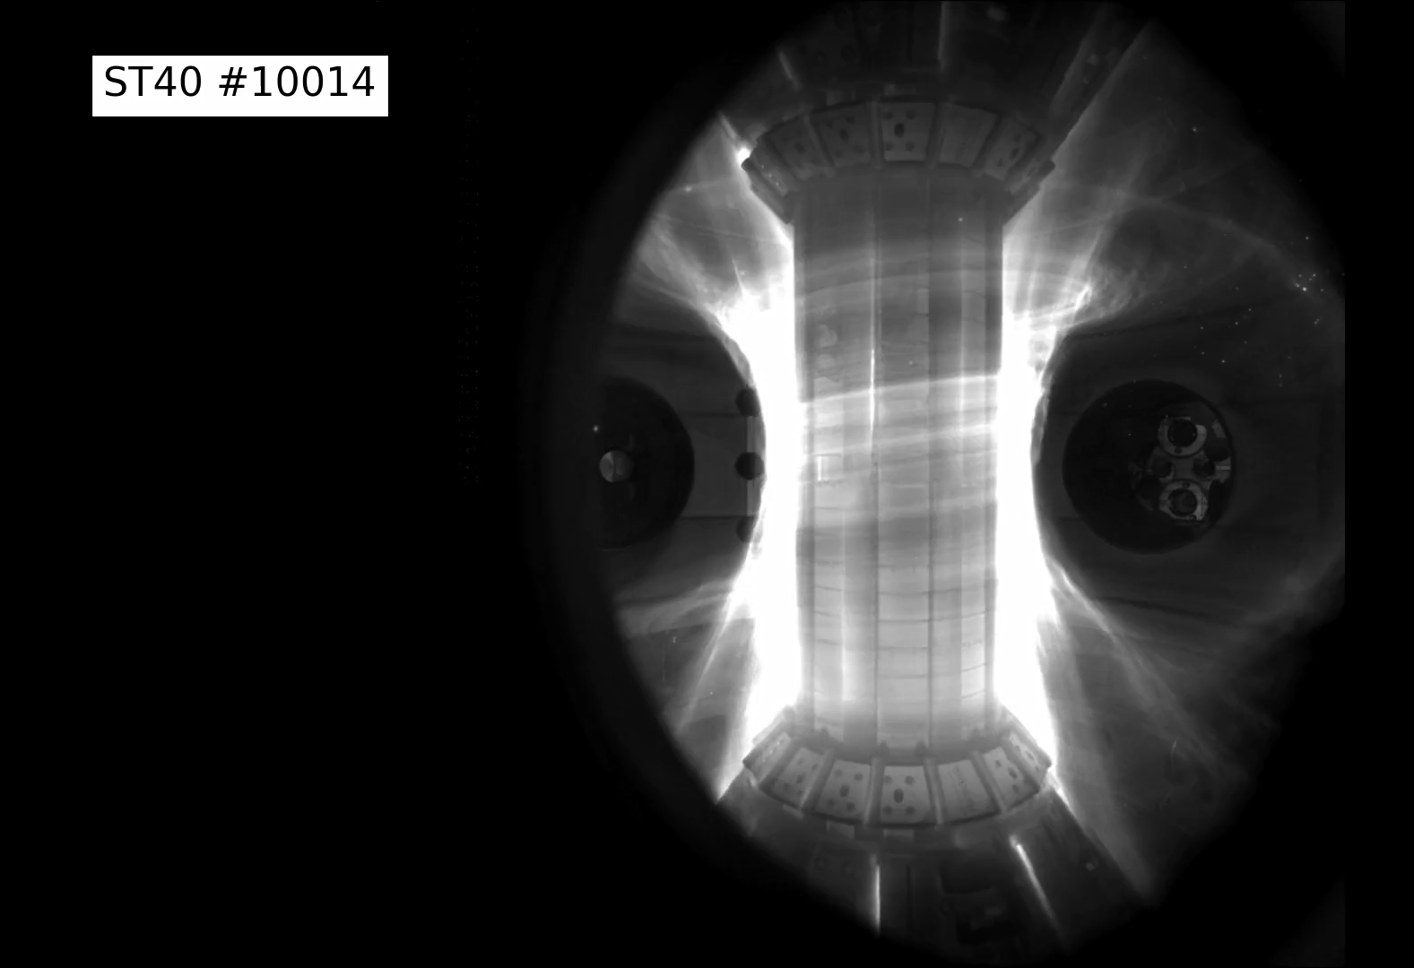

St40: Four Facts
The world’s highest-field spherical tokamak
Generating the highest nTτ of any privately-operated tokamak - 6 x 10¹⁸ keV.s/m³
Embarking on a bold $52million upgrade programme, sponsored by US and UK government
Making ST40 the most power plant-relevant spherical tokamak in the world
This is what a 100 million ˚C fusion plasma looks like on our ST40 tokamak

Slide 16
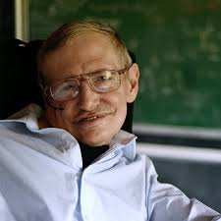
Why? Because Prof. Hawkings could imagine what the world would look like with…
Abundant energy.
Inexhaustible energy.
Safe energy.
Clean energy.

Slide 17
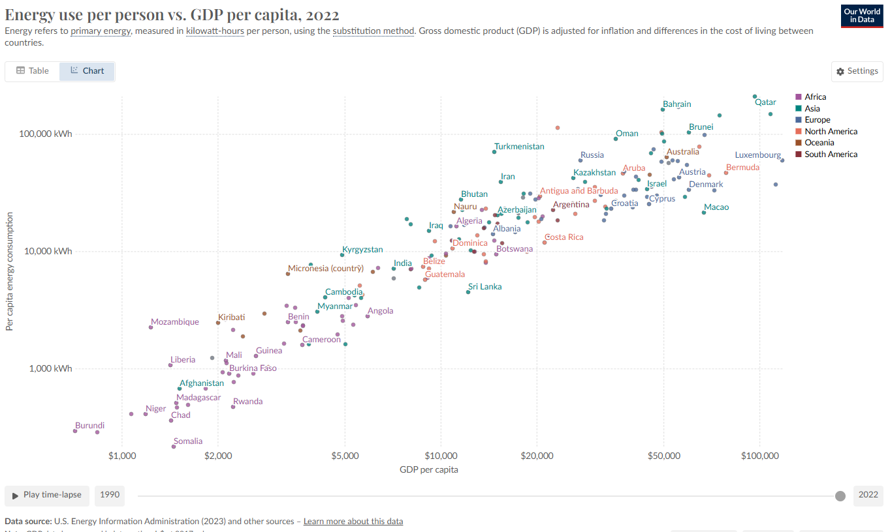
Why? Because Prof. Hawkings could imagine what a world with fusion energy would look like…
He could imagine how many people's lives throughout the world could be transformed through access to abundant, clean, safe energy:
Nowhere with low energy consumption and high living standards
1.2B people
live without access to electricity globally

Slide 18

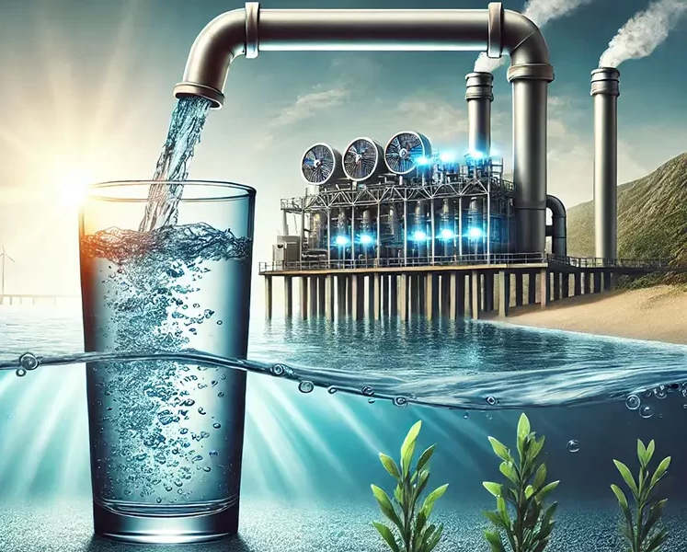
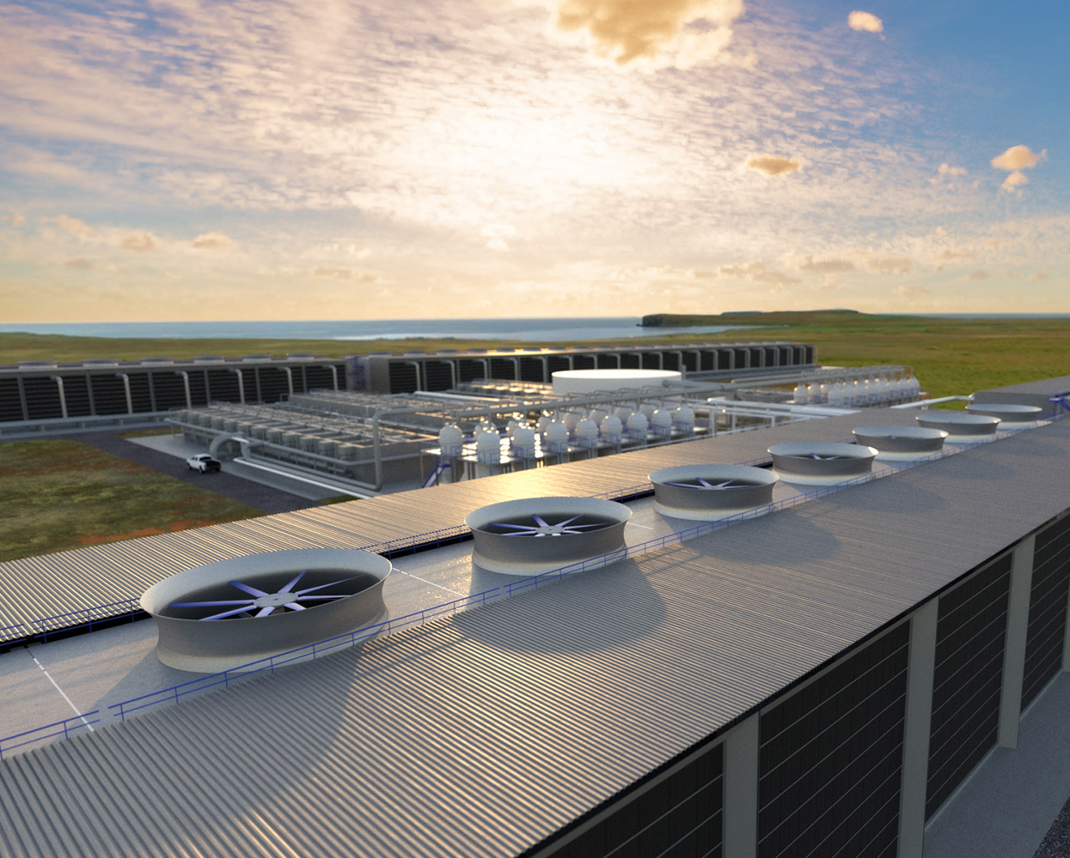
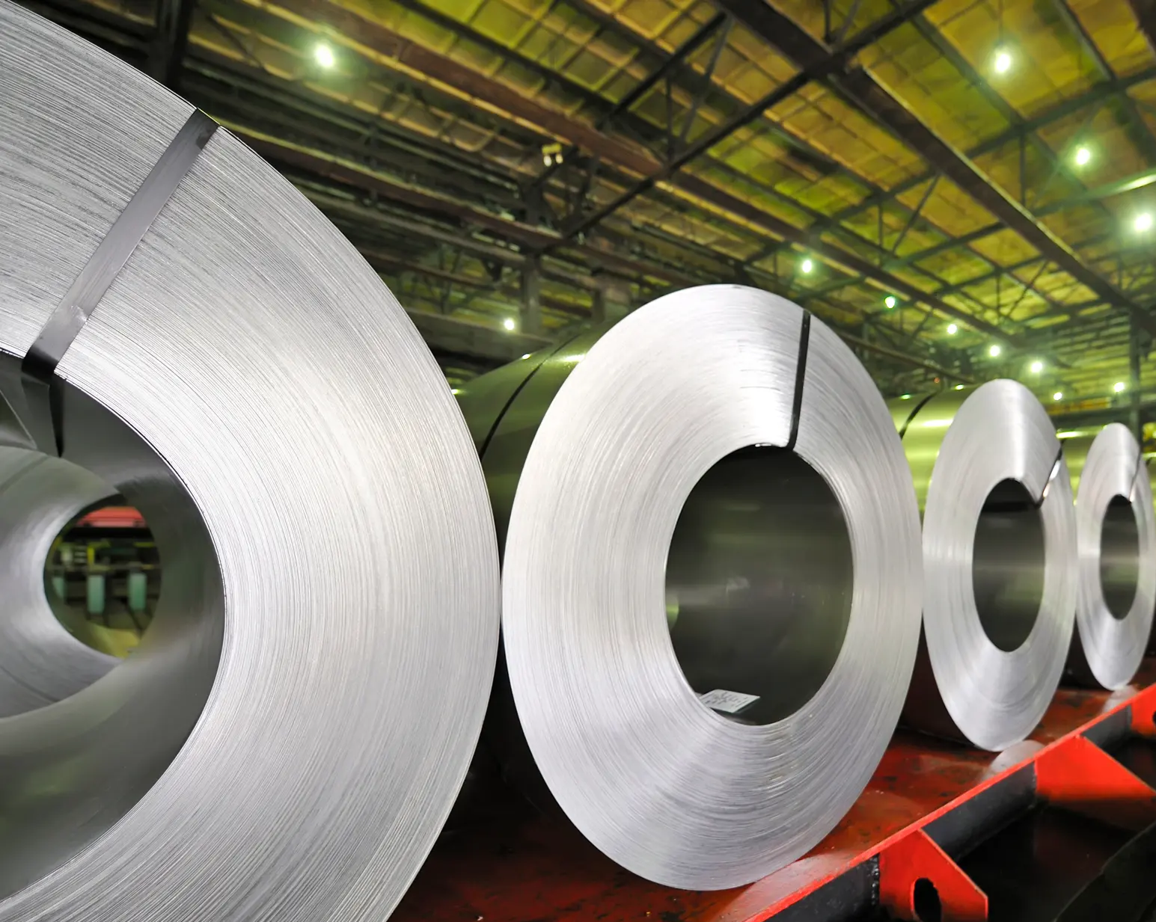
Why? Because Prof. Hawkings could imagine what a world with fusion energy would look like…
He could imagine the advances in economic and human development that could be unleashed with access to abundant, clean, safe energy:
Firm power for AI and data economies
Heat and power for desalination plants
Power for climate remediation and CO₂ capture
High-grade process heat for heavy industry and manufacturing

Slide 19
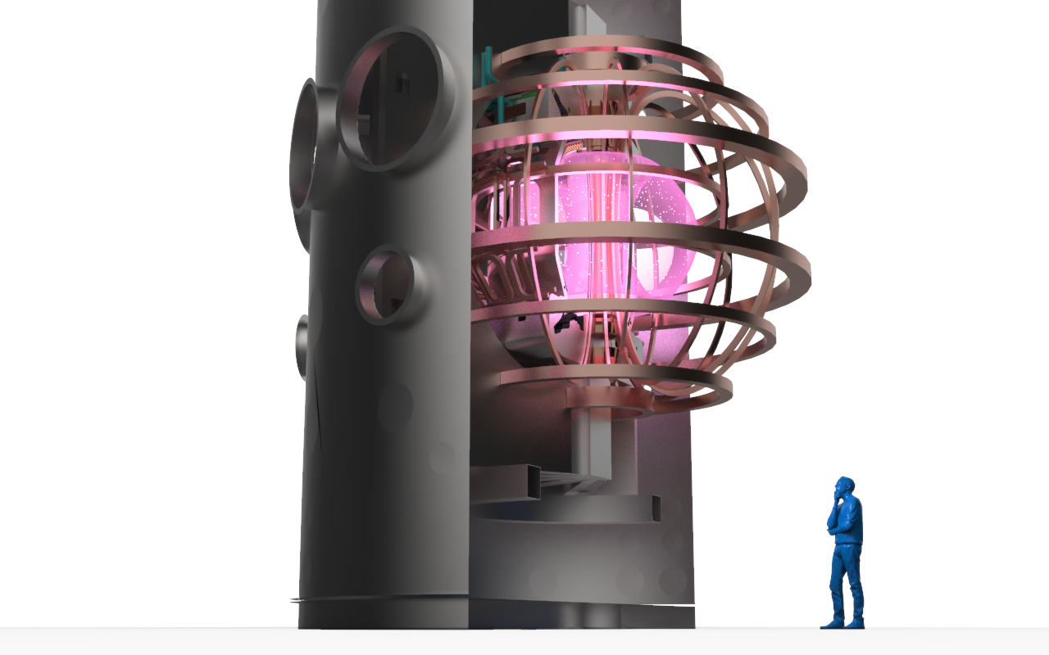

We share this conviction in the potential for fusion power to change the world!

Slide 20
Challenges in Developing Fusion
3

Slide 21
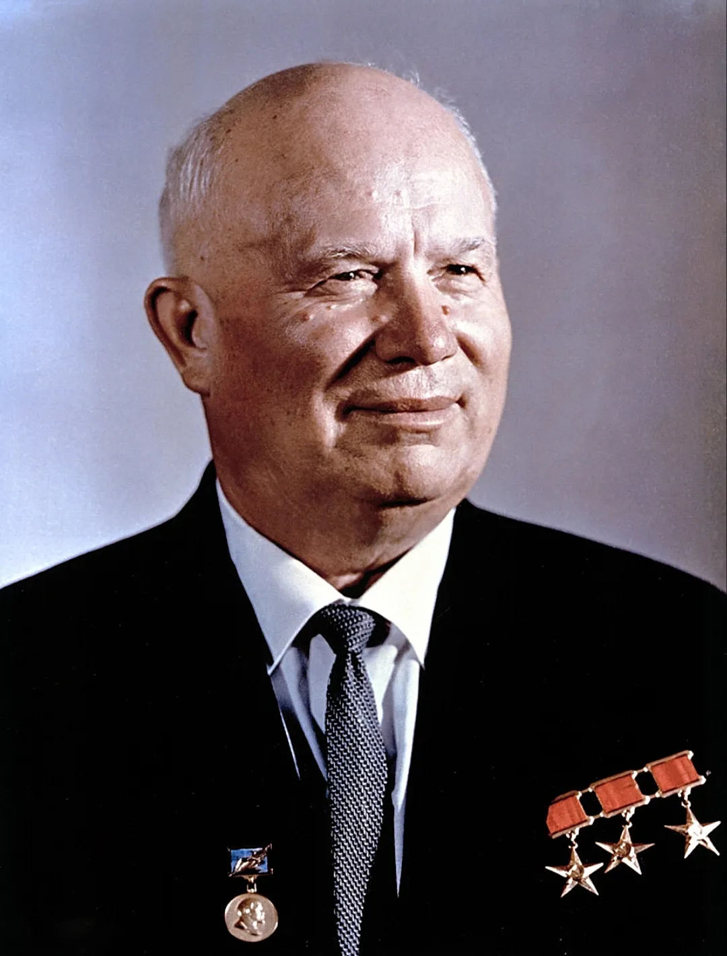
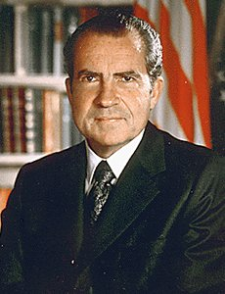
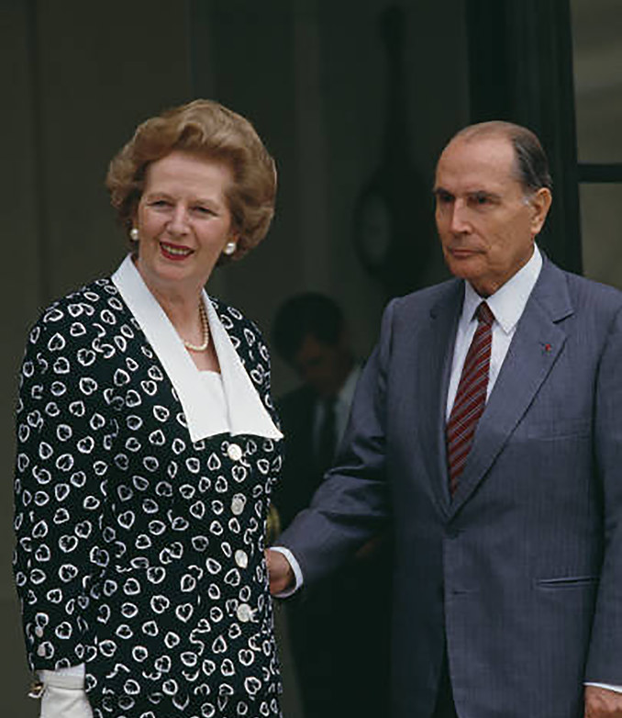
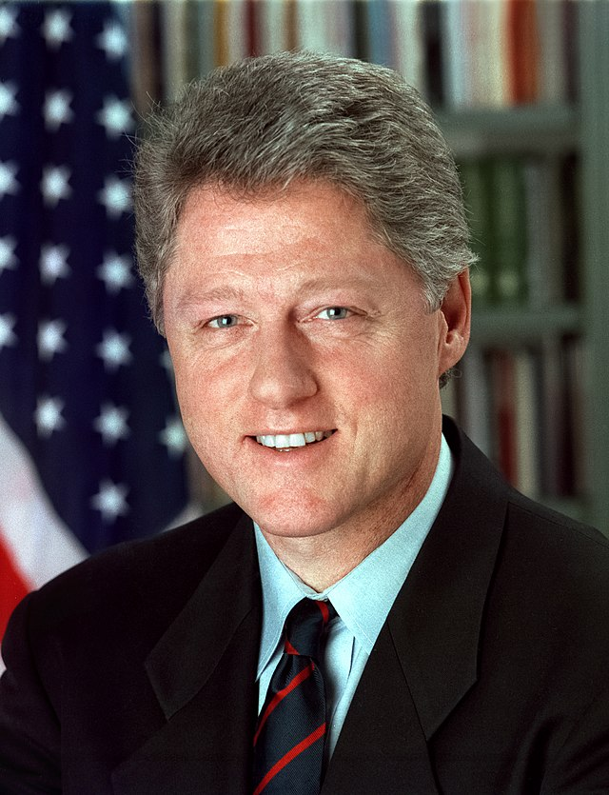
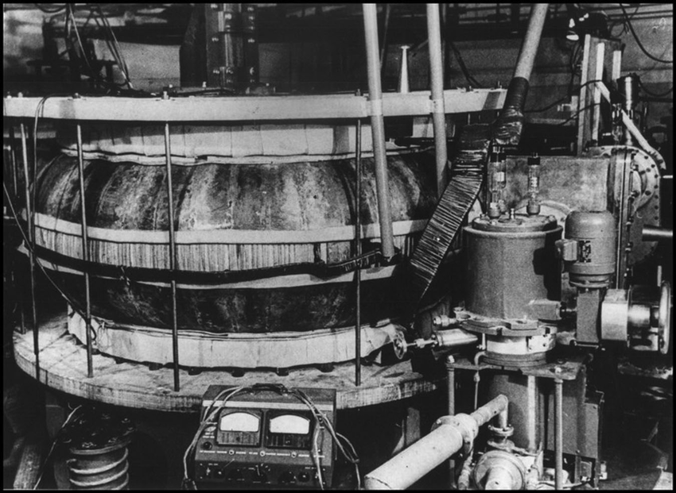
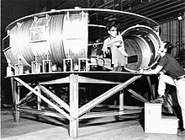
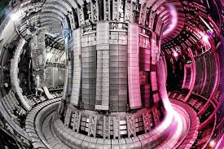
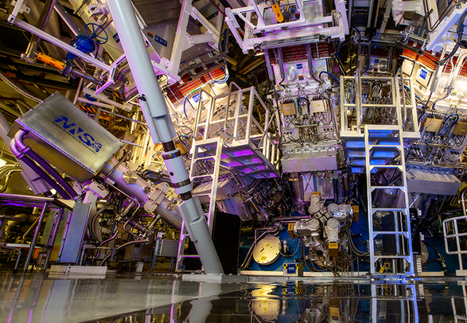
Fusion R&D has a long history
1958
T-1 Tokamak
1972
Princeton Large Torus
1983
Joint European Torus
1997
National Ignition Facility
Notes:
Well firstly, fusion is nothing new for the United States, in fact the US government has been investing in fusion R&D for decades on a rare bi-partisan concenus. Lev Andreyevich Artsimovich
Cold War rivalry with the Soviet Union in the 1960s saw the US really kick start it’s domestic fusion R&D program, driven by the breakthrough that the Soviet’s had made in developing the first Tokamak machine. This led to the Nixon Administration’s support for the first major US tokamak program – the Princeton Large Torus – in the early 1970s.
The oil crisis of the late 70s led to further interest in fusion, culminating in the construction of the advanced TFTR tokamak reactor (again at Princeton) at the end of the Carter Administration.
Advancements and investments continued throughout the 80s, with major programs like the upgrade to the DIII-D National Tokamak being initiated under President Regan.
And it was under the Clinton Administration that the National Ignition Facility at Lawrence Livermore National Lab started construction. A little over 25 years later (under President Biden), it was this laser-based approach to fusion that would deliver fusion’s first “breakthrough” moment (click to next slide).

Slide 22
What are the Business Challenges of Fusion
Raising Capital
Developing and Retaining IP
Maintaining Culture through Growth
Developing Public Private Partnerships
Commercialization metrics

Slide 23
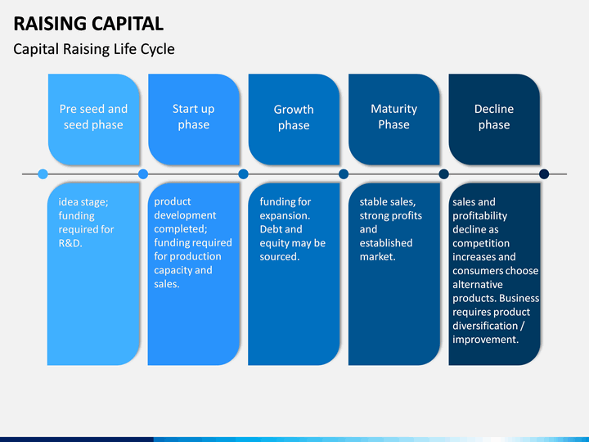

Slide 24
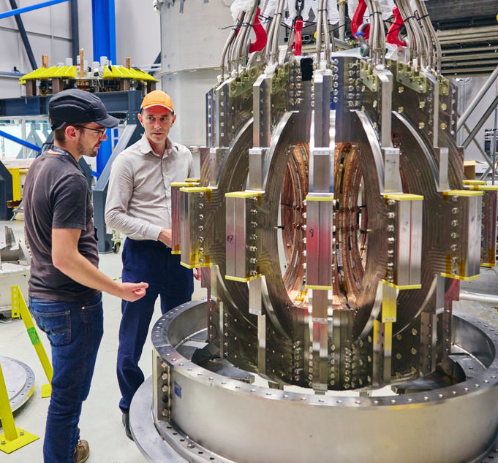
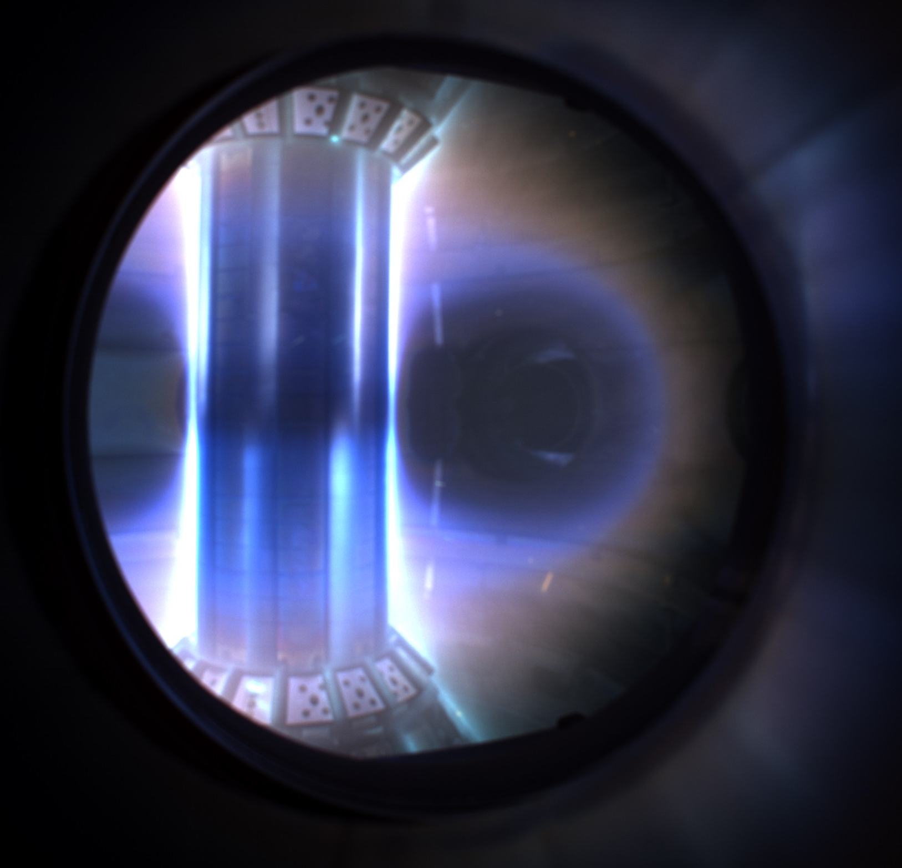
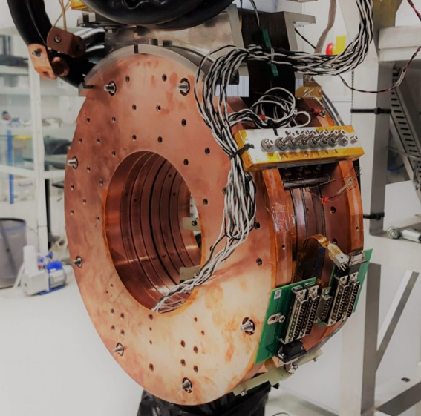
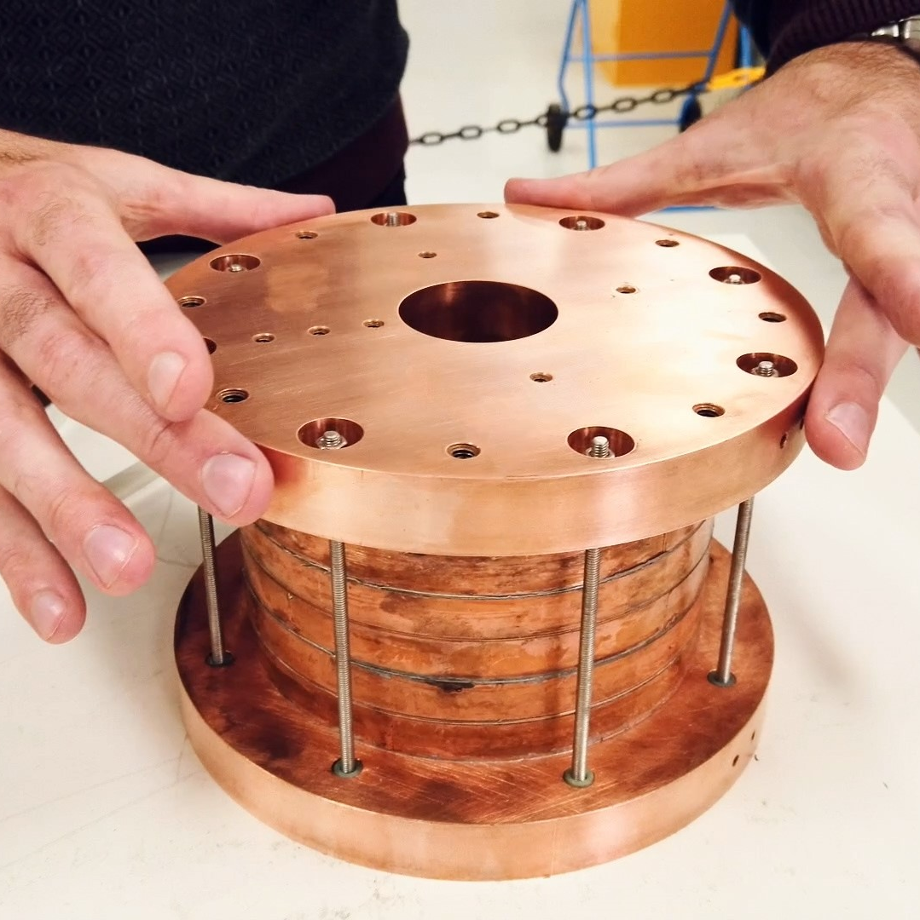
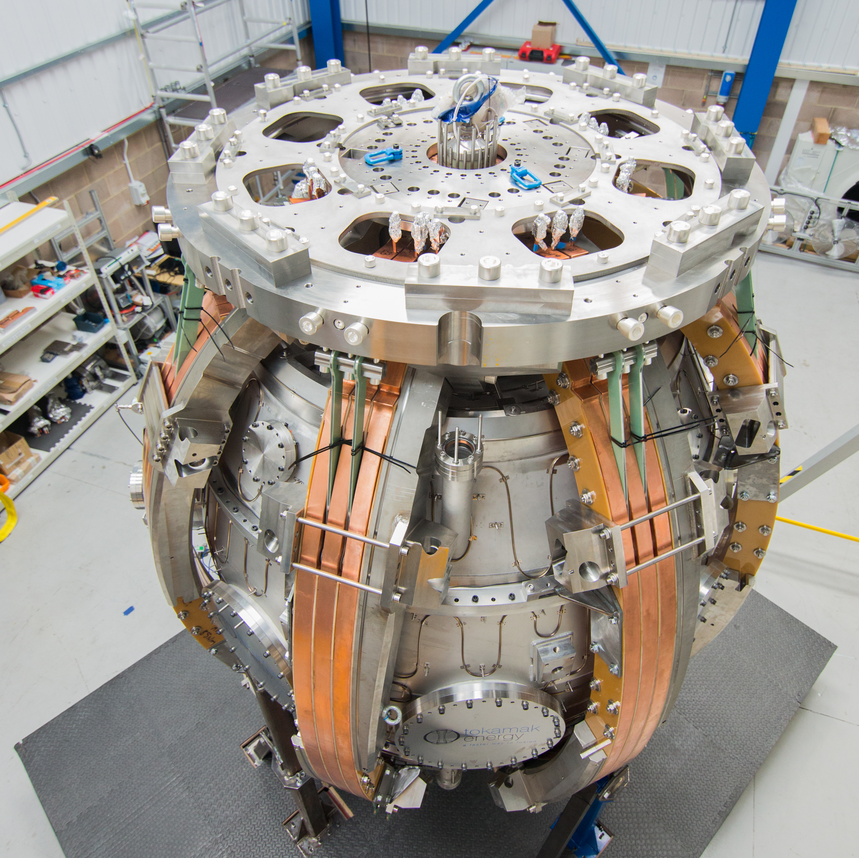
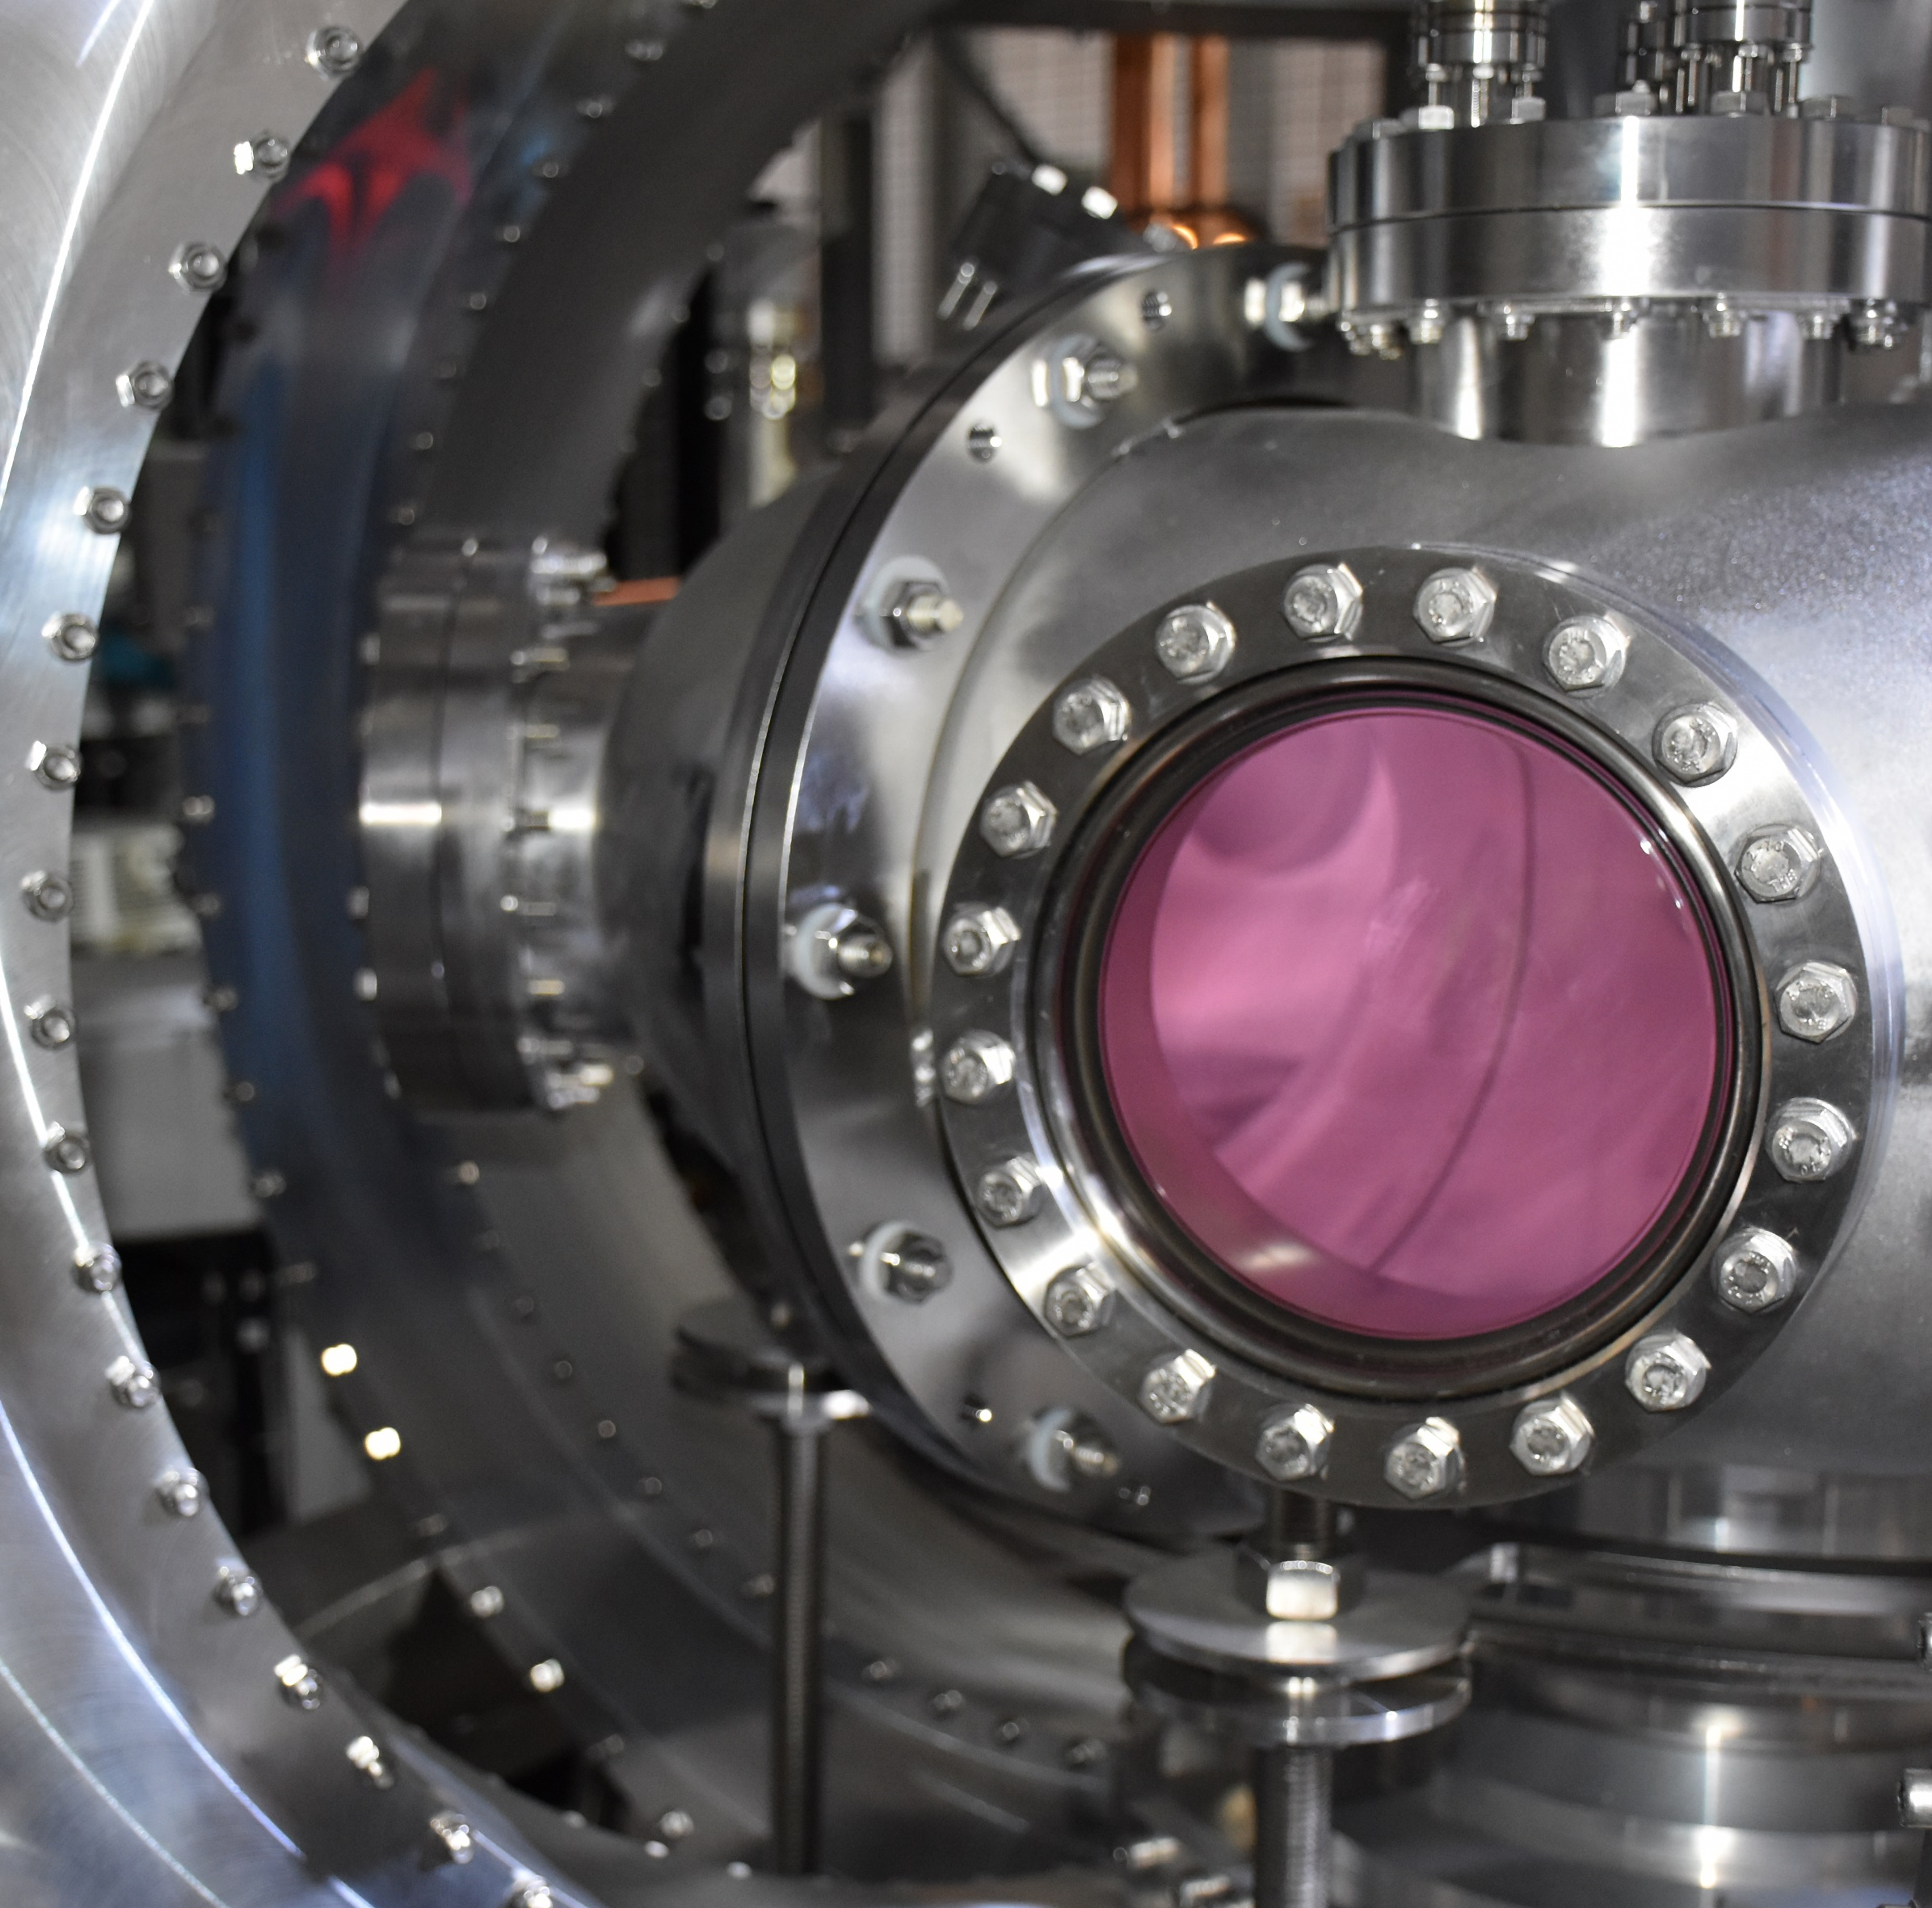

Developing and Retaining IP
Our transformative HTS and fusion technologies are protected by around 400 live patents and 77 families of patent applications, 37 of them related to our HTS magnet technology.
2024
Designed and built world-first high field HTS magnet system in tokamak configuration
Spherical Tokamak Design
HTS magnet
Technology
Plasma Control
2022
World record 100M°C plasma ion temperature and highest triple product in a spherical tokamak
6
2
Fuel Cycles
3
2
Breeder Blankets
2021
Robust, scalable, quench-safe HTS magnet technology precisely validating simulations
2
Reactor Maintenance
77 Patent
Families
Reactor Control
37
10
2019
World-record 24 Tesla field at 20 K with patented HTS magnet technology.
Plasma Facing Components
Power Supply and Cryogenics
2
Plasma Initiation and Ramp
2017
Designed, built and operating world’s highest magnetic field spherical tokamak (ST40)
2
4
Neutron Tolerant Materials
5
Mechanical
2015
First HTS tokamak sustained pulse for >24 hours with ST25 HTS
Radiation Shielding

Slide 25

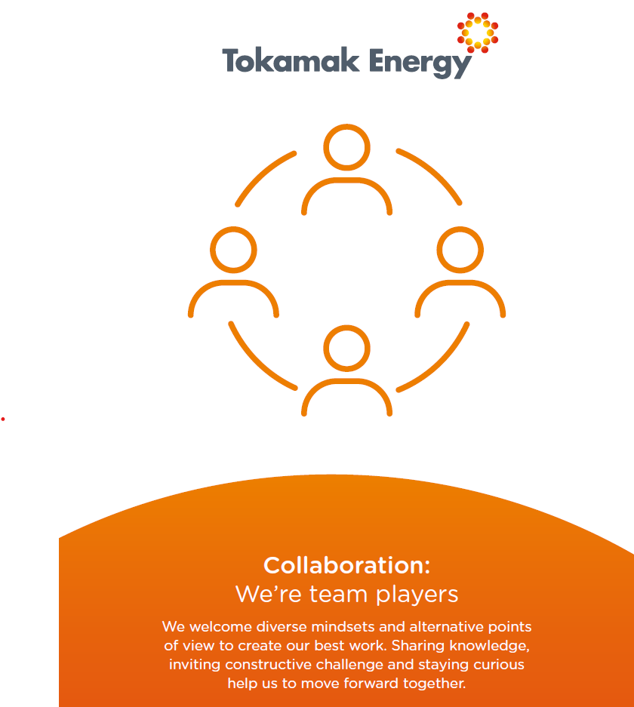

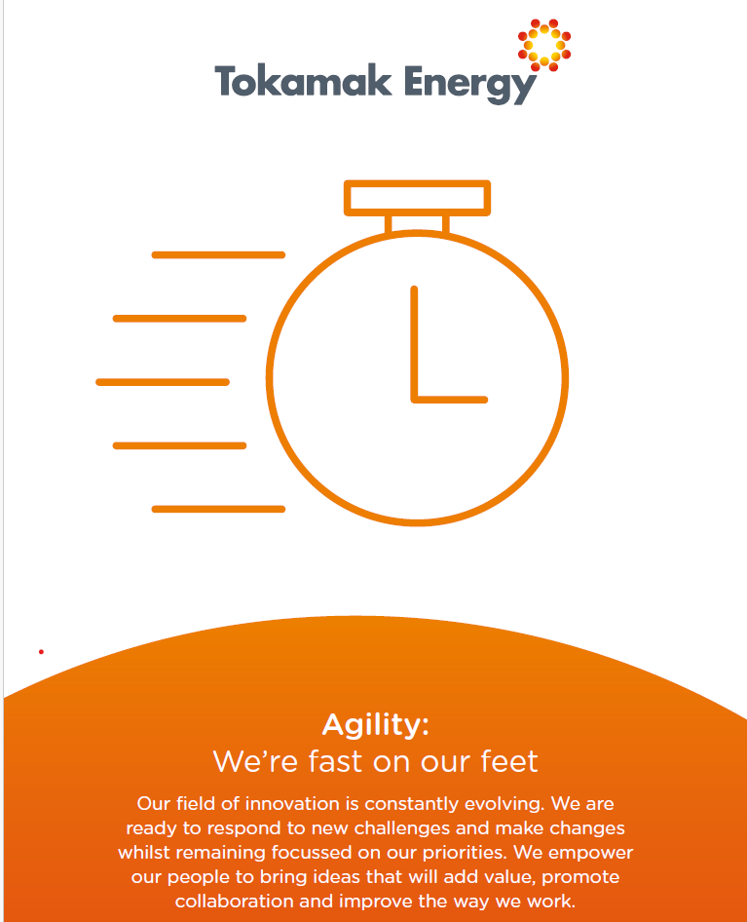
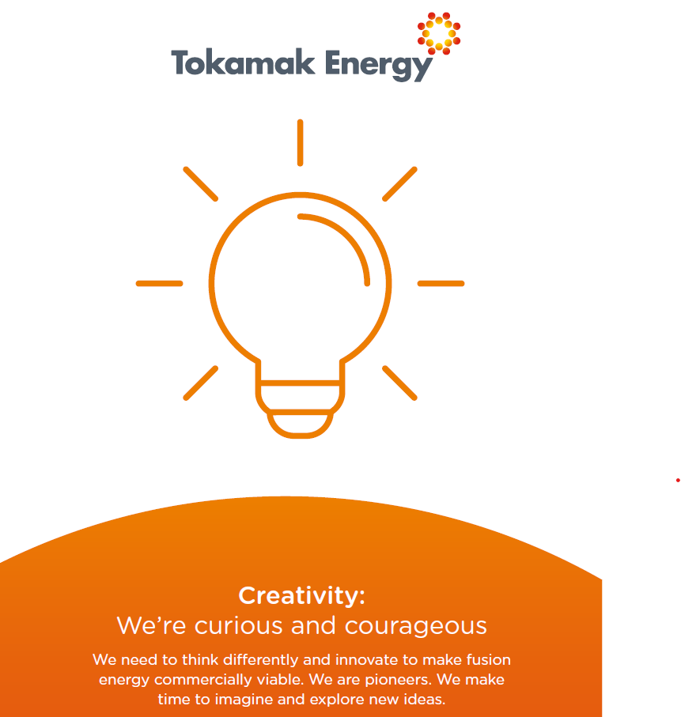

Slide 26
Public Private Partnerships
9 INFUSE awards
First CRADA in Fusion between multiple labs
  (ORNL and PPPL)
Participating with 5 of 6 FIRE consortia
Participating in 2 ARPA Chadwick awards (PFC)
DOE/DESNZ/TE joint award on LEAPS

Slide 27
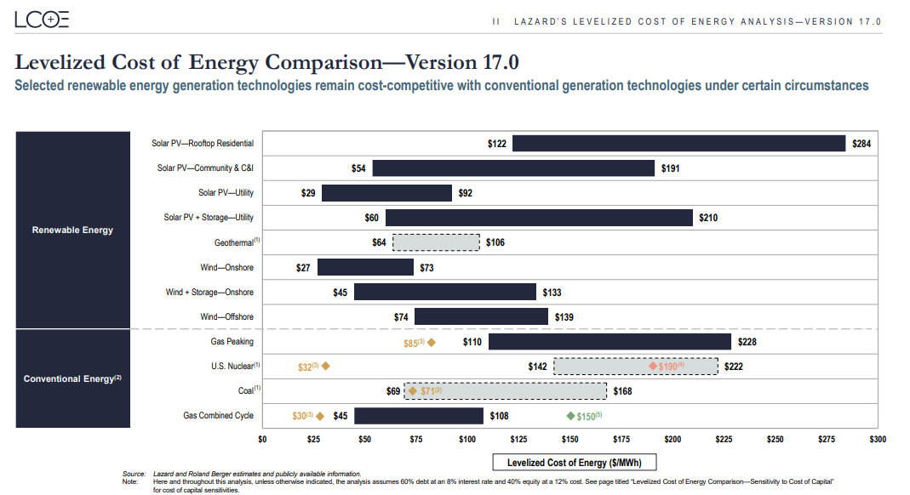

Slide 28
Our fusion technology & facilities.
4

Slide 29
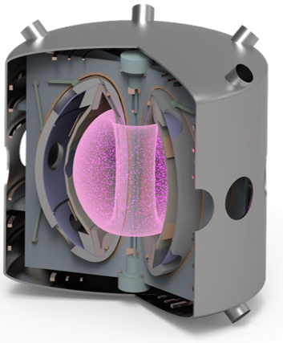




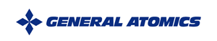



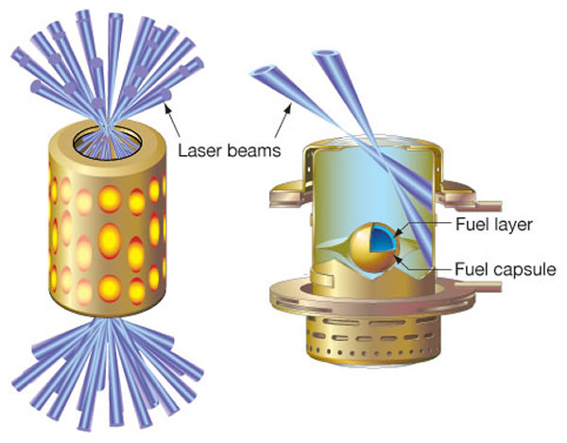
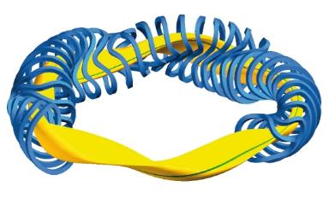








Tokamak Magnetic Confinement
Linear FRC Magnetic Confinement
Tech. Readiness | Complexity | Progress to Steady-state
Most mature fusion design | Requires planar Sup. Con. magnets & Integrated Fuel Cycle | Intermediate devices making progress, limited by current-drive TRL
Tech. Readiness | Complexity | Progress to Steady-state
Very low TRL, limited demonstration | Theoretically less complex due to linear layout | Very limited progress
Fusion
Technologies
Stellarator Magnetic Confinement
Inertial Confinement
Tech. Readiness | Complexity | Progress to Steady-state
Less studied than Tokamaks | Requires complex non-planar Sup. Con. magnets & Integrated Fuel Cycle | Limited demonstrated progress but intrinsically stable
Tech. Readiness | Complexity | Progress to Steady-state
Well studied but no progress to power plant design | Highly complex, requires multiple challenges to be overcome | Negligeable. Single shot demonstration is still state-of-the-art

Slide 30






Spherical Tokamaks
Conventional Tokamaks
Low aspect ratio
High aspect ratio
More Efficient
Higher plasma stability
More compact
Less space for shielding of central solenoid
Less Efficient
Lower plasma stability
Less compact
More space for shielding
FAST

Slide 31



Compact & efficient fusion
our fusion technology
Compact Spherical Tokamak with High Temperature Superconducting (HTS) magnets
Cost-efficient and abundant baseload power and industrial heat, delivered in a compact form-factor.
Compact spherical tokamak
High efficiency (high bootstrap current)
Stable plasma
Steady state running
Requires 50% less magnet material*
HTS magnets
Quench-safe, robust magnets
Ultra-high magnetic field (20 Tesla +)
Operate at 20K (no liquid cryogens)
* Compared to a conventional tokamak (CT)

Slide 32


Compact Spherical Tokamak
Outer vacuum chamber
Inner vacuum chamber
Toroidal Field (TF) coil: centre post
TF coils: demountable return limb
40 cm
Merging –compression (MC) coils
BVL coils
BVUB coil
ST40
Compact Spherical Tokamak
World’s highest field Spherical Tokamak
Central
Solenoid (CS)
Core-limb TF joints
Divertor (DIV) coils
S.A.M. McNamara et al. 2024 Nucl. Fusion 64 112020

Slide 33




St40 tokamak facility
ST40 Reactor
ST40 SOPHIA Simulator
ST40 Control Room
ST40 Diagnostics

Slide 34


The future for st40
An operational testbed for power plant-relevant tokamak systems.
A unique research and training facility to build operational capability and know-how for first generation of fusion power plants.
High Toroidal Field
Dominant RF Heating
Lithium PFCs
Liquid Metal Divertor
Core Fuelling w/ Pellets
Notes:
Turning ST40 into world’s most reactor-relevant spherical tokamak
Features that future power plants will have: High toroidal field, dominant RF heating and RF start-up+ramp-up (1 gyrotron, 1MW), core fuelling using pellets, metal wall, liquid metal (lithium?) divertor (solid lithium coated PFCs), long pulse operation

Slide 35

We are poised to build a bold & resilient fusion company here in the United States
Join us and power the pathway to energy abundance

Slide 36



Contact us:
Aaron.Washington@tokamakenergy.com
www.tokamakenergy.com
Thank you

